Slide 1
National Community of Practice on Supports to families
Dr. Michelle “Sheli” Reynolds, Co-Project Director
UMKC-Institute for Human Development, UCEDD
Barb Brent, Co-Project Director
NASDDDS

Slide 2
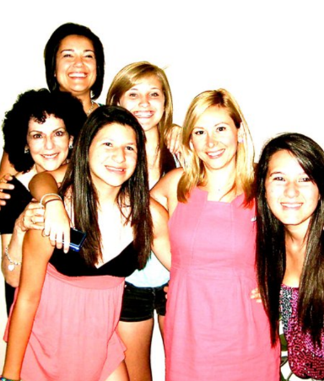
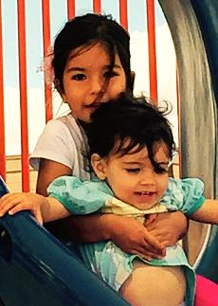
About Barb
Director of State Policy, NASDDDS
Co-Director of National Community of Practice on Supports to Families
State Director of DD in 2 States

Slide 3
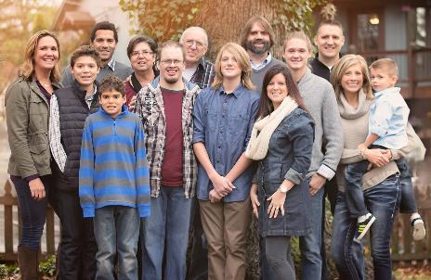
About Sheli
Sibling of three brothers, one who is 32 years old with developmental disability
Member, Presidents Committee for Persons with Intellectual Disabilities Appointed by President Obama
Director of Individual Advocacy and Family Support, UMKC UCEDD
  Supported the Self-Advocacy Movement for 12 years
  Director of Mo Family-to-Family Health Info Center
  Co-Director of National CoP on Supports to Families

Slide 4








Project Goal
To build capacity through a community of practice across and within States to create policies, practices and systems to better assist and support families than include a member with intellectual and developmental disability across the lifespan.
CT
DC
MO
OK
TN
WA

Slide 5







Project Outcomes
State and national consensus on a national framework and agenda for improving support for families with members with I/DD.
Enhanced national and state policies, practices, and sustainable systems that result in improved supports to families.
Enhanced capacity of states to replicate and sustain exemplary practices to support families and systems.

Slide 6
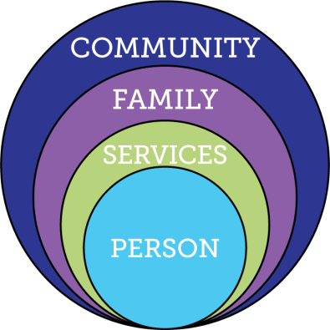
Current Reality of Service and Supports
Demand for Services
Expectations, Values, Culture
Federal Budget
Capacity of
Work Force
Federal Policy
Notes:
Key Federal Policy:
Developmental Disability Act
Individuals with Disabilities Education Act
Family and Medical Leave Act
Lifespan Respite Act
Older American’s Act
HCBS rules
Key Federal Initiatives
Medicaid Money Follows the Person
SSA Ticket to Work
Aging and Disability Resource Centers
HHS Community Living Initiative
Other Key Initiatives:
National Governors Association initiative “A Better Bottom Line: Employing People with Disabilities”
Key Federal Policy:
Developmental Disability Act
Individuals with Disabilities Education Act
Family and Medical Leave Act
Lifespan Respite Act
Older American’s Act
Key Federal Initiatives
Medicaid Money Follows the Person
SSA Ticket to Work
Aging and Disability Resource Centers
HHS Community Living Initiative
Other Key Initiatives:
National Governors Association initiative “A Better Bottom Line: Employing People with Disabilities”

Slide 7

Families Support
Members with I/DD
89% of People I/DD receiving services are living outside of residential supports
Larson, S. A., Lakin, K. C., Anderson, L., Kwak, N., Lee, J. H., & Anderson, D. (2000).
Notes:
Old title: Where Do People with Disabilities Live AND Receive Services?

Slide 8

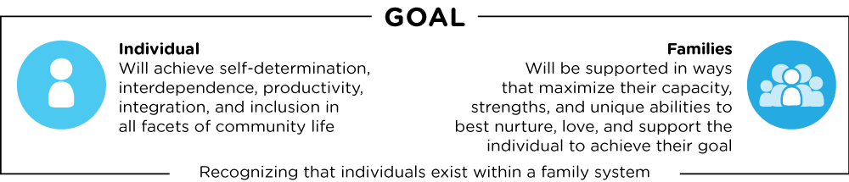
Defining Supports to Families
DISCOVERY AND NAVIGATION Knowledge & Skills | CONNECTING & NETWEORKING Mental Health & Self-Efficacy | GOODS & SERVICES Day-to-Day & Caregiving/Supports

Slide 9
Moving to Supporting Families
Family Support | Supporting Families
Defined by eligibility, services or programs available, or funding | Not a program or based on eligibility, it is needs defined by the families across the lifespan regardless of service provision
Caregiver or parent | Family is defined functionally; inclusive of siblings, parents with disabilities, grandparents
Tension between self-advocacy and family support | Enhances opportunities for self-advocacy and self-determination
Crisis, immediate response | Preventative, long-term planning
Supporting caregiver in order to decrease demand on long-term services | Creates a quality of life for person with DD and their family by supporting their many roles
Notes:
Defined by professionals or service system
As a program or specific services
Tension between self-determination/self-advocacy and family support
Goal of supporting caregiver in order to decrease demand on long-term services

Slide 10
Type of Change that is Needed
Transitional Change
Transformation Change
“Retooling” the system and its practices to fit the new model
Mergers, consolidations, reorganizations, revising systematic payment structures,
creating new services, processes, systems and products to replace the traditional one
Fundamental reordering of thinking, beliefs, culture, relationships, and behavior
Turns assumptions inside out and disrupts familiar rituals and structures
Rejects command and control relationships in favor of co-creative partnerships
Creating Blue Space, Hanns Meissner, 2013
Notes:
Transitional change – can’t just keep changing names and adding things on – have to think very differently.
The LifeCourse Framework is the way we can achieve Transformational Change
Have/change conversations; problem solve; navigate; educate; plan
Tools to give confidence, to start conversations, actually USE the tools

Slide 11
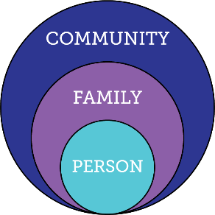
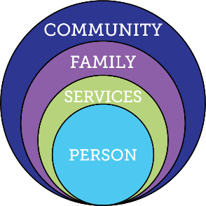
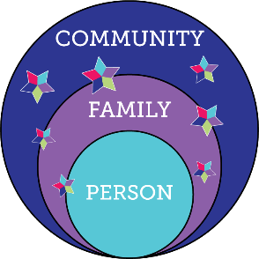
Services and Supports are Evolving
Everyone exists within the context of family and community
Integrated Services and Supports within context of person, family and community
Traditional
Disability Services

Slide 12
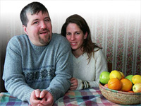
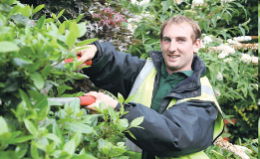

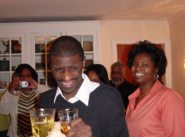
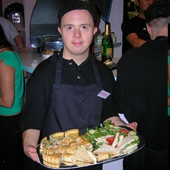

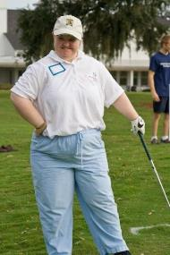
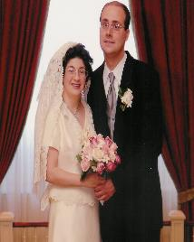
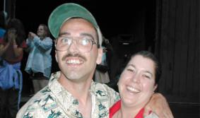
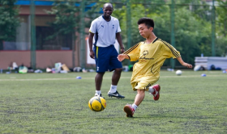
Core Belief:
All people and their families have the right to live, love, work, play
and pursue their life aspirations in their community.

Slide 13



“Good Life for All ”
The Individual will achieve self-determination, interdependence, productivity, integration, and inclusion in all facets of community life
Families will be supported in ways that maximize their capacity, strengths, and unique abilities to best nurture, love, and support all individual members to achieve their goals

Slide 14


1 in 4 Persons with I/DD
Receive Formal State DD Services
25%
100%
75%
4.7 Million people with developmental disabilities
National % Receiving State DD Services
** Based on national definition of developmental disability with a prevalence rate of 1.58%
Notes:
3 out of 4 are not getting and may never get paid DD services. Our job is to help the 3 get other kinds of support, and help ALL 4 figure out different ways of getting supports.

Slide 15
Ohioans with Disabilities
183,188 estimated Ohioans with Developmental Disabilities
20%
2%
49%
(89,737)
29%
ICF/DD
Enrolled Waiver Services
Is Active, Not on a Waiver
Based on 1.58% prevalence of 3.815 million citizens, US Census

Slide 16
Connecticut Data
52,786 estimated Connecticut's with Developmental Disabilities
?%
?%
?%
?%
ICF/DD
Enrolled HCBS DD Services
State DD Services
Targeted Case Management
Based on 1.58% prevalence of 3.59 million citizens, US Census
Notes:
Specific to Missouri – the 35% represents those that are KNOWN to the system. 19% get case management only, which if you ask an individual or family, means they aren’t getting any paid services! TCM used to be the “golden ticket” – before the Medicaid waivers, TCM meant that the SC was doing everything they could to help the individual have a good life even though they weren’t receiving paid services. We need to get back to our roots – LC tools help change THAT conversation – how can we help someone have a good life even when they get no paid services!!

Slide 17
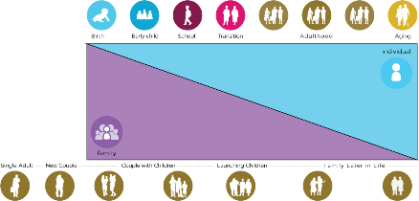
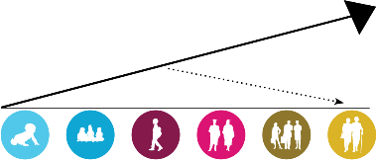

Recognizing Lifelong impact of Family:
Person Centered Supports within the context of family
Family Cycle Impacts Member Life Cycle
Family Life Experience Impacts Trajectory
Biology: Likes, dislikes, skills, abilities
Social: Family and friend network, connection with community members
Environment:
Neighborhood,
socio-economic, education
Policy:
Dreams, aspirations,
house rules, cultural rules, expectations
Family Unit Impacts Individual Level Characteristics

Slide 18






Trajectory towards Life Outcomes
Friends, family,
self-determination, community living, social capital and economic
sufficiency
Focusing on Past, Present and Future Life Experiences
Trajectory towards Life Outcomes
Vision of What
I Don’t Want
Trajectory towards things unwanted
Adapted from “Life Course Theory” and Rethinking MCH: The Life Course Model as an Organizing Framework, HRSA, Maternal and Child Health Bureau

Slide 19






Achieving Outcomes for
Connected Life Domains
Daily Life and Employment
(school/education, employment, volunteering, routines, life skills)
Healthy Living
(medical, behavioral, nutrition, wellness, affordable care)
Community Living
(housing, living options, home adaptations and modifications, community access, transportation)
Safety and Security
(emergencies, well-being, legal rights & issues, guardianship options & alternatives )
Social and Spirituality
(friends, relationships, leisure activities, personal networks, faith community)
Citizenship and Advocacy
(valued roles, making choices, setting goals, responsibility, leadership, peer support)
Notes:
Explain each domain. They are all interrelated. The service system tends to want to focus only on health and safety.
Cocktail party conversations…
Quality of life areas!!

Slide 20

Three Types of Supports
Goods &
Services
(Day to Day, Medical, Financial Supports)
Discovery & Navigation
(Info and Training)
Connecting & Networking
(Talking to Someone that has been there)
Notes:
The 100% can have access to the 3 buckets - even if they never receive formal services
YOU don’t have to know everything or provide it – but you can refer them to someone that does. Every state has a family to family organization, and many have parent to parent networks.
Judy Chezik and MPACT story

Slide 21
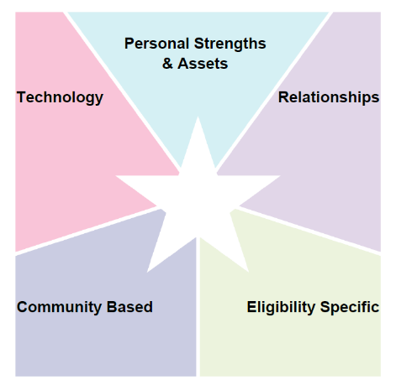
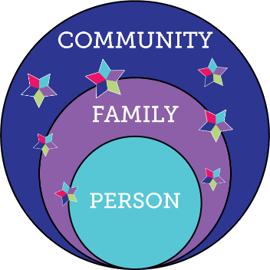

LifeCourse Integrated Supports STAR
resources, skills, abilities characteristics
i-pad/smart phone apps, remote monitoring, cognitive accessibility,
Adaptive
equipment
family, friends, neighbors, co-workers, church members, community members
school, businesses, church faith based, parks & rec, public transportation
SHS services, Special Ed, Medicaid, Voc Rehab, Food Stamps, Section 8
R
100%
Notes:
MAPPING
PROBLEM SOLVING
PLANNING LTSS
PLANNING ACTIVITIES
We ALL do this without even thinking about it

Slide 22
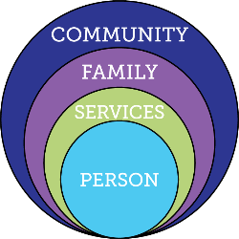

Focusing ONLY on Eligibility Supports
Friends, family, enough money,
job I like, home, faith, vacations, health, choice, freedom
Eligibility Supports
Poverty, loneliness, segregation, restrictions, lack of choice, boredom, institutions
Notes:
Story about family asking permission for their son (who doesn’t receive services for housing) to move into his own apartment
OATS bus -

Slide 23
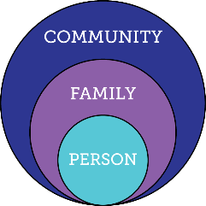

Relying ONLY on Family & Friends
Friends, family, enough money,
job I like, home, faith, vacations, health, choice, freedom
Relationships
Poverty, loneliness, segregation, restrictions, lack of choice, boredom, institutions

Slide 24
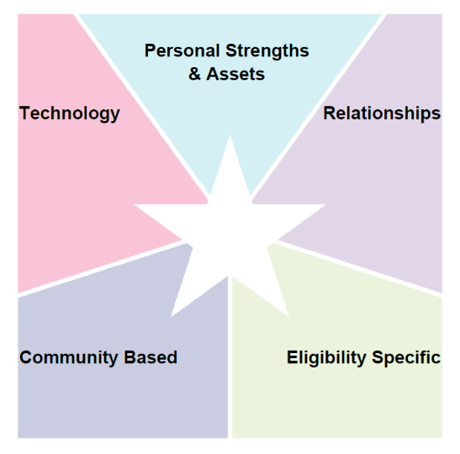
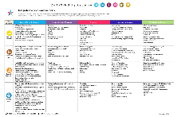

Daily Activity Problem Sovling
Focus Area
Notes:
Activity 7: Integrated Supports Star large group discussion: Large 11x17 Star worksheet
Ask participants to call out the things they use to get through their day. IE: what types of supports do you use to get through your morning routine or evening routine? (5 minutes)
Record the things used to accomplish the routine on the flip chart or poster board as they call it out
IE: alarm clock =technology, Starbucks = community, meal with family = relationships, school buss – community, carpool – relationships, morning person: personal strength, etc.
Facilitate large group discussion, lead, nudge or pull them to the realization that we all use integrated supports every day?

Slide 25
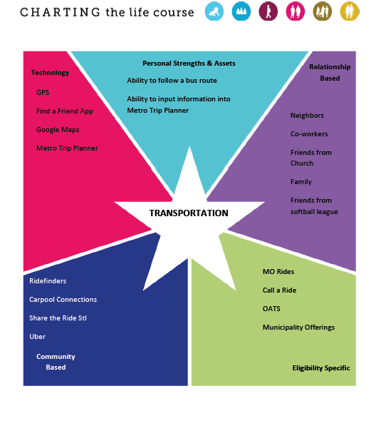
The Arc StL
Problem Solving for
Info and referral

Slide 26
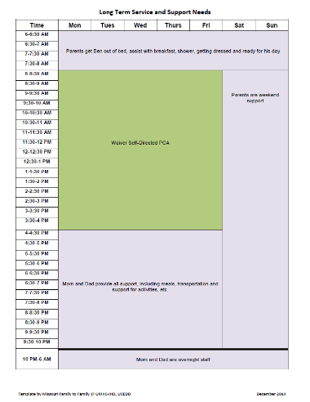

Focusing on Services and Supports

Slide 27
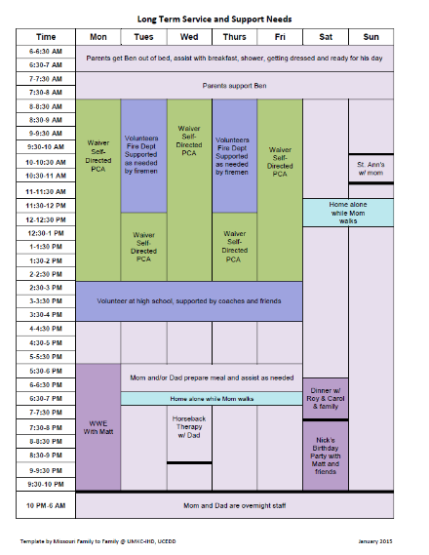
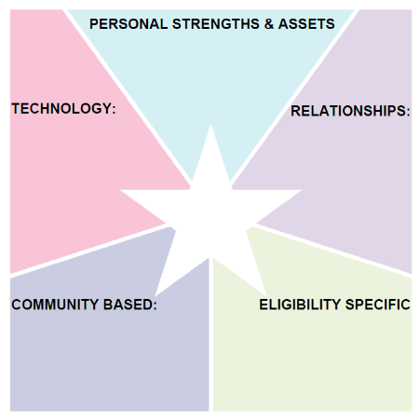
Mapping Services and Supports
Able to stay home alone for up to an hour; has & can use i-pad;
i-pad when home alone; digital watch
Mom, Dad, Matt, Zac, Ali, Chad, Ericka, Roy, Carol, Nick, Spohn,
Ben’s Services & Supports
Firemen at ESFD; coaches & staff at ES high school; Omni bus;
DDD Self-Directed waiver PCA staff; Medicaid; Special Needs Trust

Slide 28
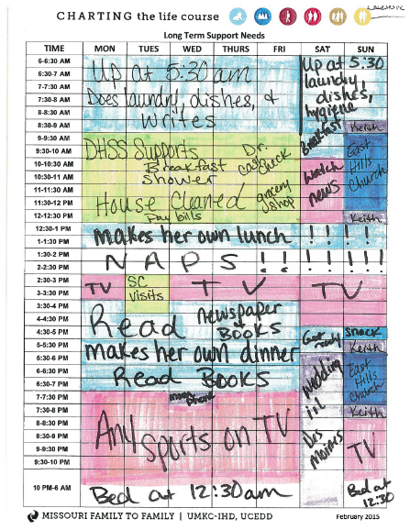
Calendar to Star/Planning

Slide 29
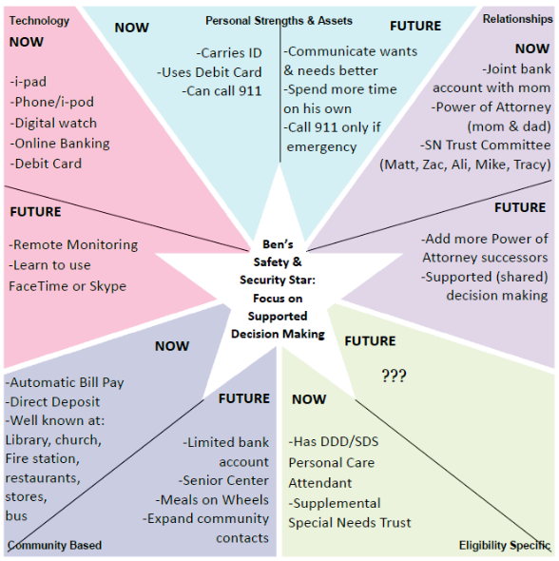
Ben’s Safety & Security Star
Focus on Supported Decision Making
Notes:
Now and future – succession planning

Slide 30
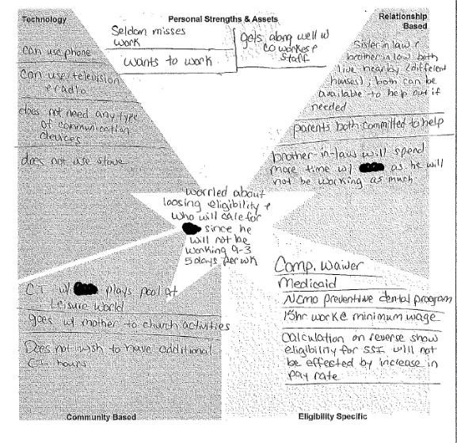
Problem Solving:
Employment is decreasing from 30 to 15 hours a week
Parents are worried about who will provide supports during 15 hours not working
Concerned about losing eligibility of services

Slide 31

Partnering with People with Disabilities and their Families so they can
Engage, Lead, and Drive
Policy and Systems Change

Slide 32

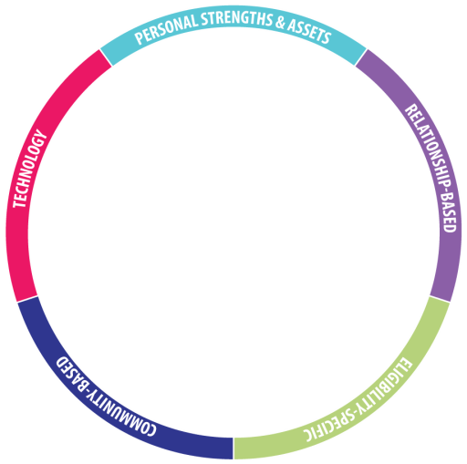
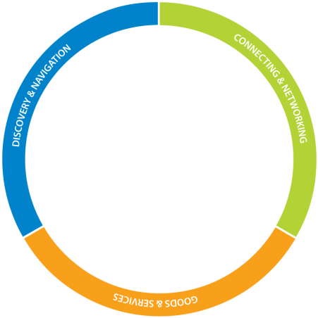
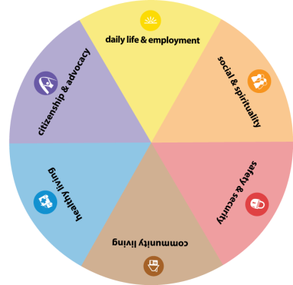


Notes:
First show the person,
Then show the family,
then bring up the domains
And then the buckets
And then the outer layers
All these things work together to make a good life.

Slide 33

Supporting Families in Connecticut

Slide 34
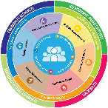

What is Connecticut’s Vision for Supported Families?
Vision for Strong and Supported Families
Write down your responses on your worksheet & discuss with your table
Notes:
Ask the group Who said: Family/friends; vacations, pets, chocolate, etc
How many people said: Good Behavior Plan????
EVERYBODY “gets” what “good life” means

Slide 35
What DON’T you want??
What happens when families aren’t supported?
Write down your responses on your worksheet
& discuss with your table
Notes:
Who said: Poverty, isolation, segregation, loneliness?
Ask the group for anything else they put there that hasn’t already been said.
Family sometimes cant envision the good life – too many barriers, always a fight. But they can almost always tell you what they DON’T want!

Slide 36
ALL: Public Health Framework
Medical System
Flu Shot
Hand Washing
Anti-Bacterial Soap

Slide 37
Constructing Universal Strategies for Supporting Individuals with Disabilities and Families Across the LifeCourse
Government
Public-Private Partnerships
Community Resources
Long Term Services and Supports
-Family and Self-Advocacy Networks
-Aging and Disability Resource Centers
-No Wrong Door Initiatives
-Area Agencies on Aging
-Parent Training Info Centers for Education
-United Way 211
Accessed by all citizens:
-Faith based communities
-Parks and Recreation
-Businesses
-Emergency Personnel

Slide 38


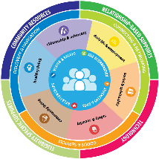




Comprehensive, Integrated & Coordinated Systems Across Life Domains & Stages
Pediatrician, Families and Friends, Faith based
IDEA Part C, Parents as Teachers, Health, Headstart
School, Special Education, Health, Recreation
Vocational Rehab, Health Employment, College, Military
Disability Services, Health, Housing, College, Careers
Retirement, Aging System, Health

Slide 39


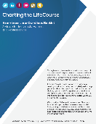
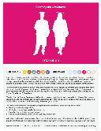
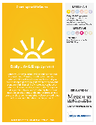
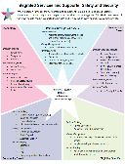
Reframing for All Stakeholders:
Developing Materials
Family to Family at Missouri UCEDD
Early Childhood, Part C
School Districts, Special Education
PNS Show Me Career Grant Pilot Sites
State Division of Developmental Disability
Special Health Care Needs
Dept. Health and Senior Services
Vocational Rehabilitation

Slide 40


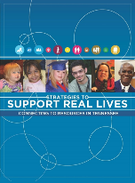
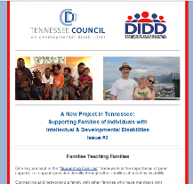

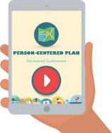

Reframing for All Stakeholders:
Disseminating Broadly
Tennessee
Washington

Slide 41
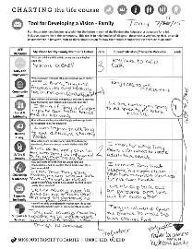
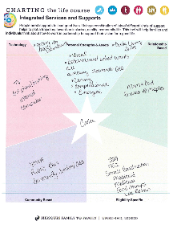
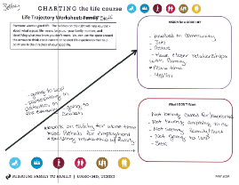
Reframing for All Stakeholders:
Focused Education and Training
Self-Advocates and Families
Partners in Policymaking Classes
Person Centered Planners
Teachers and School Professionals
Employment Professionals

Slide 42


State Structures
Connecting Families to Support at the Front Door

Slide 43



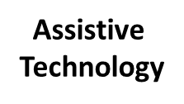
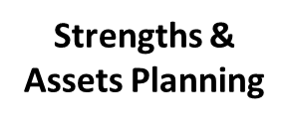
State Structures
Support Coordinator Training
Eligibility
Services
DDS Services
Person Centered Planning

Slide 44
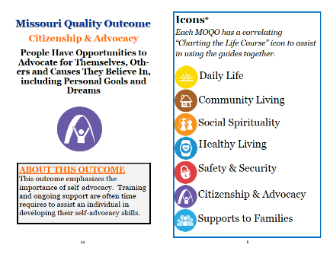
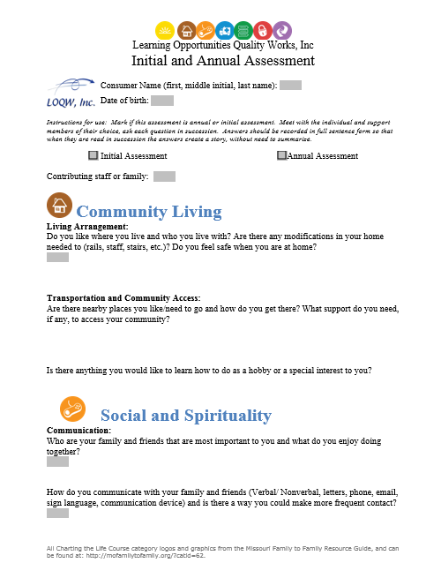
State Structures
Person Centered Planning and HCBS Rules

Slide 45


Draft ISP Template

Slide 46




Integrating Systems and Initiatives:
Youth Transition and Employment
Statewide Employment Leadership Network (SELN)
Employment First State Leadership Mentor Program

Slide 47


LifeCourse School Portfolio
Abilities First
One Page School Profile
Notes:
Worked with UMKC-IHD UCEDD/MoF2F to revise the LifeCourse general portfolio into a School Portfolio

Slide 48

Adult Employment Trajectory

Slide 49


Integrating Systems and Initiatives:
No Wrong Door/ ADRC
No Wrong Door SYSTEM
Focus of
CoP Supports to Families and
DD System:
Support Coordination
Person Centered Thinking, Planning, and Facilitation
Family Navigation and Family Neworks
LifeCourse Framework and Tools
Responding to new CMS HCBS rule
Focusing on Front Door of DD Services

Slide 50


State Structures
State Waitlists
OK
Strategies:
Strengthen Information Access
Provide Resource Navigation and Improve Inter-Agency Service Coordination
Provide family-to-family support to individuals and families who are currently on the Waiting List or who apply for Waiver Services.
Assess needs of families currently on the Waiting List.
Build capacity of services and supports outside of those provided through DDS waivers.

Slide 51


Organizational Strategic Thinking:
Evolving Day Habilitation Services

Slide 52

Team within an Organization

Slide 53


State Structures
Medicaid State Plans and Waivers
Employment and Community First CHOICES Waiver
for Tennesseans with I/DD (Amendment 2)
  Family Caregiver Education and Training
  Community Support Development, Organization and Navigation
  Peer–to-Peer Self-Direction, Employment and Community Support and Navigation

Slide 54
What does K Plan: Community First Choice change
about our current system?
Current:
Future:
Entitlements (State Plan)
Other Medicaid
Entitlements (State Plan)
Other Medicaid
Institutional
Home and Community-Based
Home and Community-Based
Institutional
Home and Community-Based
Home and Community-Based
Nursing Facilities or
ICF/ID
Nursing Facilities or
ICF/ID
Medicaid Personal Care:
Personal Care
Waivers:
Personal Care
PERS
Equipment
Assistive Technology
Home Modifications
Respite
Therapies
Habilitation
Employment Support
Other
New - Community First Choice:
Personal Care
Required CFCO Services
Optional CFCO Services?
More Flexibility?
Improved outcomes
Waivers:
Will look different in some cases
May become more of a wrap-around service to CFCO?
New: A client is potentially eligible for both
Current: client is eligible for one or the other

Slide 55
Connecticut Community of Practice
Celebrating the Last Four Years

Slide 56


Connecticut Successes
Promotion of use of Charting the LifeCourse materials and tools across systems and organizations
LifeCourse Ambassadors
Family members are disseminating LifeCourse materials to other families
CT DDS Integrated Supports Options document
IP Committee is working to incorporate LifeCourse materials in the DDS IP

Slide 57


Connecticut Successes
Flyer on Transition Stages
CT Life Experience Booklet
CT Daily Life & Employment Booklet
Front Door Experiences: Eligibility & HelpLine

Slide 58


Connecticut Successes
Advocates Corner provides self-advocates with information about self-advocacy and self determination
The Family to Family Connections brochure provides information about family groups that can be useful allies to families.
The Connecticut Sibling Connection is an organization with the mission to support siblings of individuals with disabilities.
Peer to Peer Supports is a new waiver service offered to people served by CT DDS. This empowering service allows DDS consumers to get paid to help mentor and support their peers
Family Mentoring Group formed to bring together family organizations for communication exchange

Slide 59


Connecticut Successes
SERC is using LifeCourse materials in teacher trainings
LifeCourse training has been provided at all of the CONNCASE regional meetings
Teachers and transitional staff are beginning to use LifeCourse materials in schools
LifeCourse trainings have been provided to DSS staff

Slide 60


The DD Council, UCEDD, OPA, and CT Tech Act staff are partnering with DDS in implementing the DDS Good Life Technology Campaign
SERC and the Tech ACT demonstration sites have expanded to include technology for people with IDD
An AT lifespan brochure has been created to help people understand their rights regarding AT
DDS has contracted with TYZE so that families can access this service free of charge

Slide 61


A Positive Behavior Support brochure and PBS family video has been developed to help families understand how positive behavior supports can be beneficial across the lifespan
A Respite Brochure has been developed to help families understand the variety of types of respite supports that area available to families
An In-Home Supports COP committee has developed training materials for providers
A recreation COP committee has developed a social skills pilot at a DDS respite center

Slide 62
Mapping Connecticut’s Successes
Reframing at All Levels

Slide 63
Next Steps for Year 4/5
Reframing at All Levels

Slide 64

National CoP Next Steps:
Supporting Families Focus Areas
Year 4 & 5
Providers Partnering with Families
Self-Directed Supports and Families
Goods and Services Specific to Family or Caregiver
Building Capacity of Community to Support Families

Slide 65

Ways to
Get involved!
NASDDDS June 2016 Conference
Website
State Updates
LifeCourse Framework Resources
Listserv for Project Highlights
Webinars (Quarterly Live and Archived)
supportstofamilies.org

Slide 66







LifeCourse
Educational Materials
LifeCourse
Tools
Lifecoursetools.com
Notes:
TOOLS – might just use to take NOTES; eventually will guide your thinking and conversations. Person or family doesn’t have to fill out or even know you are using the tool. Can use very broadly or very specific to a need or situation.

Slide 67
Contact Information
Sheli Reynolds reynoldsmc@umkc.edu
Barb Brent bbrent@nasddds.org

