Slide 1

Charting the LifeCourse Across the Lifespan
May 18, 2016
Connecticut
Notes:
Do evaluation
Update Mo # slides

Slide 2
Before we start - Please answer the first question on evaluation!
Notes:
FILL OUT 1st question on evaluation!!!!!!!

Slide 3
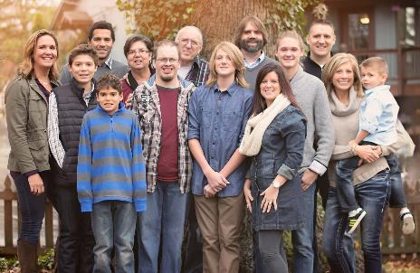
About Sheli
Sibling of three brothers, one who is 32 years old with developmental disability
Member, Presidents Committee for Persons with Intellectual Disabilities Appointed by President Obama
Director of Individual Advocacy and Family Support, UMKC UCEDD
  Supported the Self-Advocacy Movement for 12 years
  Director of Mo Family-to-Family Health Info Center
  Co-Director of National CoP on Supports to Families

Slide 4
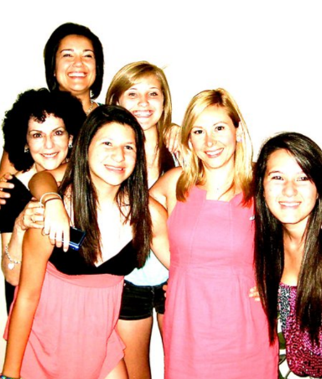
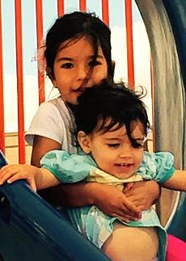
About Barb
Director of State Policy, NASDDDS
Co-Director of National Community of Practice on Supports to Families
State Director of DD in 2 States

Slide 5
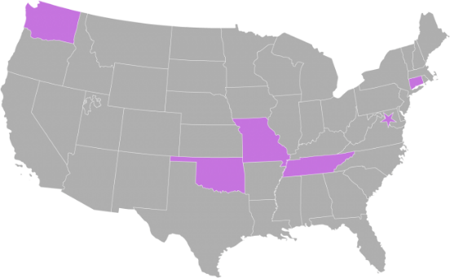
National Community of Practice on Supporting Families
Project Goal
To build capacity through a community of practice across and within States to create policies, practices and systems to better assist and support families that include a member with I/DD across the lifespan.
Project Outcome
State and national consensus on a national framework and agenda for improving support for families with members with I/DD.
Enhanced national and state policies, practices, and sustainable systems that result in improved supports to families.
Enhanced capacity of states to replicate and sustain exemplary practices to support families and systems.
Notes:
COP charged with developing a framework for supporting families
Chose to model after the life course theory
Informed by Wingspread-Building a National Agenda for Supporting Families with a member with IDD
Framework started with Mo F2F stakeholders. Plain language, not systems jargon.

Slide 6









Funded in 2012 by
National Partners

Slide 7

Introductions
Meet the people at your table
    Introduce yourself
BRIEFLY share what was your first job
Notes:
Who’s here?
Family Members/Self-Advocates
Employment Professionals/Specialists
Education Professionals
Support Coordinators
DSPs
Other
Ask them to introduce themselves at their tables and share briefly what their first job was. Right now employment is a very important topic for PWD, but also important because your work experiences influenced how you got where you are today. That’s what today is all about – opportunities and experiences and how they influence life outcomes.
Why? Topic of employment is at the forefront and important, but also --- How you got where you are today ar the experiences and opportunities you have had along the way – you probably aren’t still doing what your first job was. Today is about all that and more.

Slide 8
Outcomes for Today
Explore the effect of past and current policies and practices of the disability service system on available supports
Highlight the significant role families play in their members with disabilities lives across the lifespan
Introduce the LifeCourse Framework as a foundation for working with individuals with disabilities and their families to achieve a “good life”
Provide real life examples and strategies that can be used to impact the trajectory towards a “good life”
Notes:
First bullet – you all do policy everyday. We fight things, it causes change. Its important to understand the intent of federal laws and policies.
2nd bullet – this is not typical in our field. We tend to focus on providing the services the individual needs, like it has nothing to do with the person’s family! Or we talk about the family until the child is an adult and then we only talk about the person!
Last 2 bullets – Last thing we want to do is give you one more piece of paper to fill out. We want to provide tools you can supplement into your work IF and WHEN it makes sense! We hope these tools will integrate and enhance your conversations.

Slide 9
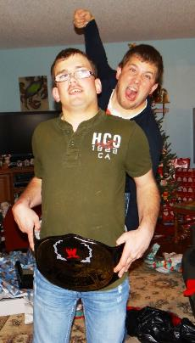
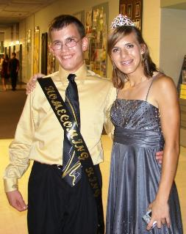
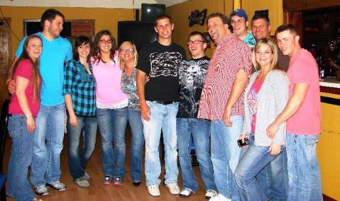

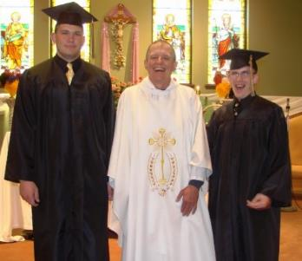
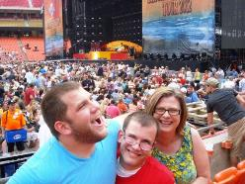
Setting the Stage

Slide 10
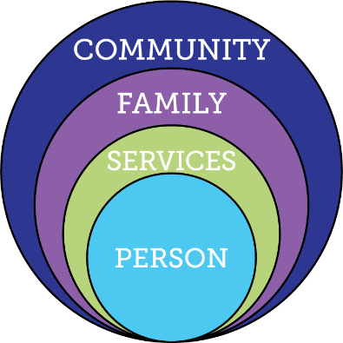
Current Reality of Service and Supports
Demand for Services
Expectations, Values, Culture
Federal Budget
Capacity of
Work Force
Federal Policy
Notes:
DEMAND for services going UP, while BUDGET is going DOWN. Workforce – females between 25 and 45, going DOWN. Elderly using $ and people resources that IDD also uses.
Expectations of younger generation that has grown up with FULL iinclusion.
Policy – moving away from institutional and congregate settings, and employment and community inclusion is an expectation.
Providers expected to do MORE for less
Key Federal Policy:
Developmental Disability Act
Individuals with Disabilities Education Act
Family and Medical Leave Act
Lifespan Respite Act
Older American’s Act
HCBS rules
Key Federal Initiatives
Medicaid Money Follows the Person
SSA Ticket to Work
Aging and Disability Resource Centers
HHS Community Living Initiative
Other Key Initiatives:
National Governors Association initiative “A Better Bottom Line: Employing People with Disabilities”
Key Federal Policy:
Developmental Disability Act
Individuals with Disabilities Education Act
Family and Medical Leave Act
Lifespan Respite Act
Older American’s Act
Key Federal Initiatives
Medicaid Money Follows the Person
SSA Ticket to Work
Aging and Disability Resource Centers
HHS Community Living Initiative
Other Key Initiatives:
National Governors Association initiative “A Better Bottom Line: Employing People with Disabilities”

Slide 11
Center for Medicaid Services- HCBS Final Rule
Federal Policy
Settings Rule: Individuals have the right to receive services in the community to the same degree as those not receiving home and community based waiver services
Person Centered Planning: Service plans for HCBS must be developed through a person-centered planning process that provides necessary information and support so that the individual can direct the process and make informed choices.
Home and Community Based Services (HCBS) Final Federal Rule Presentation, 11/10/16

Slide 12
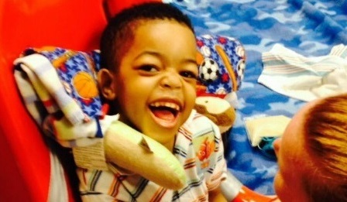
Guiding Principles For the
Supporting families LifeCourse Framework

Slide 13
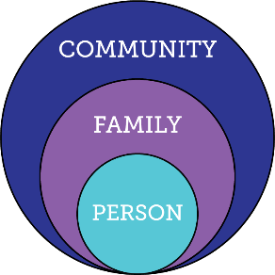
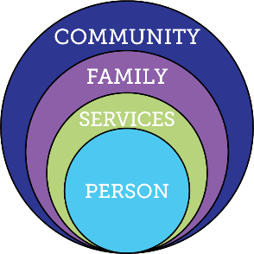
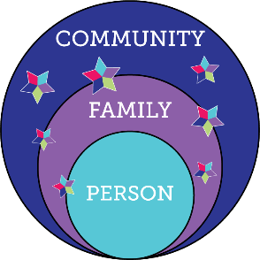
Services and Supports are Evolving
Everyone exists within the context of family and community
Integrated Services and Supports within context of person, family and community
Traditional
Disability Services

Slide 14
Type of Change that is Needed
Transitional CHange
Transformation Change
“Retooling” the system and its practices to fit the new model
Mergers, consolidations, reorganizations, revising systematic payment structures,
creating new services, processes, systems and products to replace the traditional one
Fundamental reordering of thinking, beliefs, culture, relationships, and behavior
Turns assumptions inside out and disrupts familiar rituals and structures
Rejects command and control relationships in favor of co-creative partnerships
Creating Blue Space, Hanns Meissner, 2013
Notes:
Transitional change – can’t just keep changing names and adding things on – have to think very differently.
The LifeCourse Framework is the way we can achieve Transformational Change
Have/change conversations; problem solve; navigate; educate; plan
Tools to give confidence, to start conversations, actually USE the tools

Slide 15
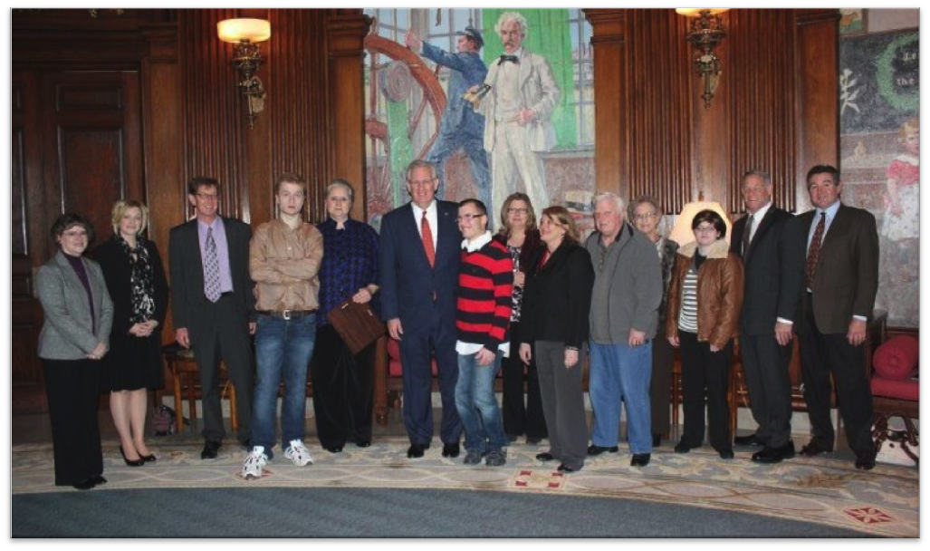
Policy, Systems & Community Change:
Person-/Family- Centered and Driven

Slide 16

Partnering with People with Disabilities and their Families so they can
Engage, Lead, and Drive
Policy and Systems Change

Slide 17


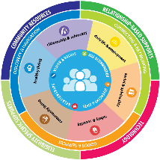




Comprehensive, Integrated & Coordinated Systems Across Life Domains & Stages
Pediatrician, Families and Friends, Faith based
IDEA Part C, Parents as Teachers, Health, Headstart
School, Special Education, Health, Recreation
Vocational Rehab, Health Employment, College, Military
Disability Services, Health, Housing, College, Careers
Retirement, Aging System, Health

Slide 18
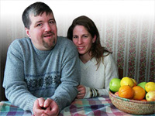


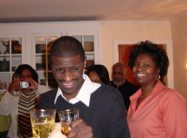
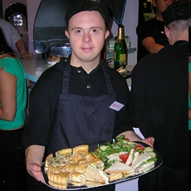
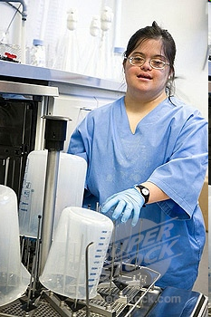
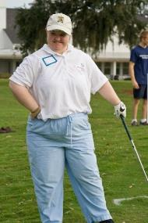
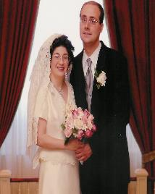
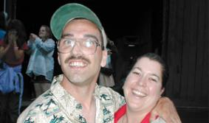
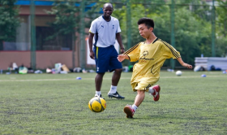
Core Belief:
All people and their families have the right to live, love, work, play
and pursue their life aspirations in their community.

Slide 19
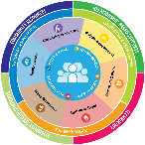

What is YOUR Vision
for a Good LIFE?
Vision of What I Want for a Quality of Life
Write down your responses on your worksheet & discuss with your table
Notes:
Ask the group Who said: Family/friends; vacations, pets, chocolate, etc
How many people said: Good Behavior Plan????
EVERYBODY “gets” what “good life” means

Slide 20
What DON’T you want??
Vision of What
I Don’t Want
Write down your responses on your worksheet
& discuss with your table
Notes:
Who said: Poverty, isolation, segregation, loneliness?
Ask the group for anything else they put there that hasn’t already been said.
Family sometimes cant envision the good life – too many barriers, always a fight. But they can almost always tell you what they DON’T want!

Slide 21



“Good Life for All ”
The Individual will achieve self-determination, interdependence, productivity, integration, and inclusion in all facets of community life
Families will be supported in ways that maximize their capacity, strengths, and unique abilities to best nurture, love, and support all individual members to achieve their goals

Slide 22
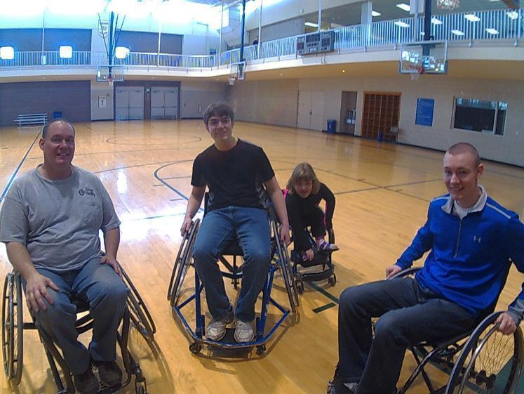
ALL People

Slide 23


1 in 4 Persons with I/DD
Receive Formal State DD Services
25%
100%
75%
4.7 Million people with developmental disabilities
National % Receiving State DD Services
** Based on national definition of developmental disability with a prevalence rate of 1.49%
Notes:
3 out of 4 are not getting and may never get paid DD services. Our job is to help the 3 get other kinds of support, and help ALL 4 figure out different ways of getting supports.

Slide 24
Missourians with Disabilities
95,498 estimated Missourians with Developmental Disabilities
13%
3%
65%
(62,498)
19%
ICF/DD
Enrolled HCBS DD Services
State DD Services
Targeted Case Management
Based on 1.58% prevalence of 3.815 million citizens, US Census
Notes:
Specific to Missouri – the 35% represents those that are KNOWN to the system. 19% get case management only, which if you ask an individual or family, means they aren’t getting any paid services! TCM used to be the “golden ticket” – before the Medicaid waivers, TCM meant that the SC was doing everything they could to help the individual have a good life even though they weren’t receiving paid services. We need to get back to our roots – LC tools help change THAT conversation – how can we help someone have a good life even when they get no paid services!!

Slide 25
Connecticut Data
52,786 estimated Connecticut's with Developmental Disabilities
?%
?%
?%
ICF/DD
Enrolled HCBS DD Services
State DD Services
Targeted Case Management
Based on 1.58% prevalence of ?? million citizens, US Census
Notes:
Specific to Missouri – the 35% represents those that are KNOWN to the system. 19% get case management only, which if you ask an individual or family, means they aren’t getting any paid services! TCM used to be the “golden ticket” – before the Medicaid waivers, TCM meant that the SC was doing everything they could to help the individual have a good life even though they weren’t receiving paid services. We need to get back to our roots – LC tools help change THAT conversation – how can we help someone have a good life even when they get no paid services!!

Slide 26
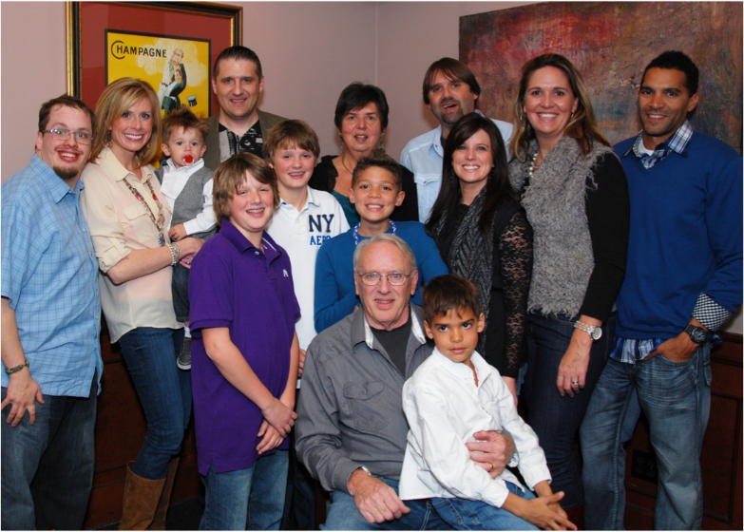
Person Within Context of Family & Community

Slide 27

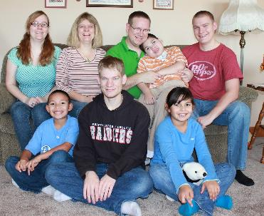
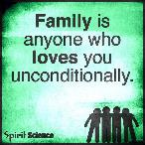
All individuals exist within the context of family
Family is defined by the individual
Individuals and their family may need supports that adjust as roles and needs of all members change
Not dependent upon where the person lives
Notes:
No matter if person lives with their family (or not), talks to (or not) or if the family goes to meetings with the person
We have to be OPEN to their definition of family!

Slide 28

Lifelong Impact of
Family on Individual
Biologically: Likes, dislikes, skills, abilities
Socially: Family and friend network, connection with community members
Environmentally: Neighborhood, socio-economic, education
Policy:
Dreams, Aspirations,
House rules, cultural rules, expectations
Notes:
Biology – are we tall or short? Do we inherit tendency for certain illness? What do I want to do or be?
Socially – impact of reputation of the family – good or bad (like in school if you had an older brother/sister attend before you); connected socially/social networks (what are those connections and reputations??)
Environmentally – the neighborhood we grow up in; our family’s education level, financial status;
Policy – house rules and expectations; important to understand expectations and norms. (everyone expected to go to college; make your bed every morning) Family CULTURE – so important – what you do on holiday, birthdays, traditions and things that are important in your family culture; how to hang stockings. WHO is going to know the family rituals???

Slide 29



Relationships and Roles of Family in a Person’s Life
Caring About | Affection & Self-Esteem
 | Repository of knowledge
 | Lifetime commitment
Caring For | Provider of day-to-day care
 | Material/Financial
 | Facilitator of inclusion and membership
 | Advocate for support
*Adapted from Bigby & Fyffe (2012), Dally (1988), Turnbull et all (2011)
Notes:
#1 fear of all parents/families --- what will happen when I’m GONE?
Having conversations with families (especially parents) about “Caring About” – who else can fill these roles when you are gone, and how can you start giving some of those things to others NOW while you are still around?
It doesn’t matter if you think you have all the “caring for” covered when you’re gone – what if it all falls apart? If there is no one that cares ABOUT the person to figure it out, then it’s all for naught.
AND who does the person care about? Do they send cards or call on birthdays for loved ones? Is there someone they are about that they also care FOR? (ie- interdependent relationships especially with older families)
RECIPROCAL - reciprocity

Slide 30

Families Support
Members with I/DD
89% of People I/DD receiving services are Supported by Family
Larson, S. A., Lakin, K. C., Anderson, L., Kwak, N., Lee, J. H., & Anderson, D. (2000).
Notes:
Old title: Where Do People with Disabilities Live AND Receive Services?

Slide 31
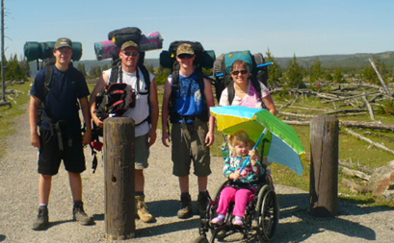
Life Trajectory, Experiences and Life Stages

Slide 32
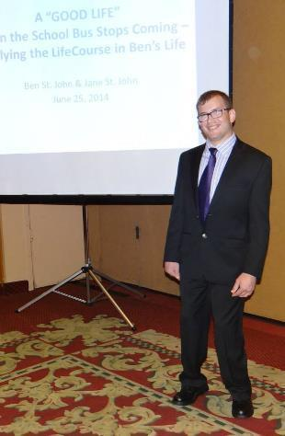
Introducing Ben

Slide 33
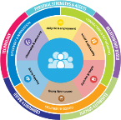
Vision for a Good Life
The future is not something we enter. The future is something that we create. And creating that future requires us to make choices and decisions that begin with a dream.
    -Leonard L. Sweet
Notes:
How can you plan with people if you don’t know their finish line?
Resource Center – we try to figure out WHY they are asking for a service – story about mom asking for DayHab because her son actually needed transportation to his job and dayhab has transportation.

Slide 34
Trajectory towards Good Life
Friends, family,
enough money,
job I like, home, faith, vacations, health, choice, freedom
Trajectory towards Life Outcomes
Vision of What I Don’t Want
Trajectory towards things unwanted
Notes:
What kinds of things did you say earlier for YOUR good life? PWD and families usually want those same types of things. Everybody “gets” what the good life is. We just don’t usually ask them! What kinds of things do you think PWD and families will say they DON’T want? Sometimes you need to start there – they may not know what they want (because they are thinking in disability world) but they almost always can tell you want they don’t. FAMILY should have a good life trajectory too
TRAJECTORY is the path that will either lead you toward the good life or toward things you don’t want. Think about throwing a football – the path that the ball takes on it’s way to the receiver is the trajectory. If you shoot an arrow, or a nerf gun – the path that the arrow follows is the trajectory. CAN START at ANY AGE!!!!
Support coordinators, providers, DSP’s, VR counselors, teachers….. ALL have the power to impact someone’s trajectory, sometimes negatively, by their actions or words. We must be very careful and mindful of the impact we can have. Are we nudging person and family toward what they want or what they don’t want?? EACH interaction, think about which way it pointed their trajectory!
KINDERGARTEN story – segregated class and safer special bus

Slide 35
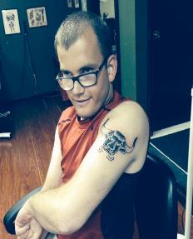
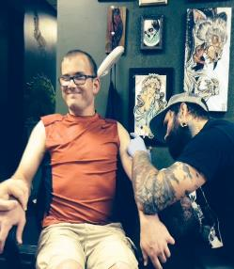
Ben’s Good Life Vision
Family Friends TATOOS
Vacations Girlfriend
Concerts WWE Nascar
Money Job/own business
Fire Station Church
Tiger Football Royals
Good Food Pepsi Beer
Active Healthy & Fit
Poverty/No Money
Poor Health Diabetes
Heart Disease Guardian
Isolated/Segregated
Institution/group home
Treated Differently
Notes:
Trajectory isn’t always straight
Bumps in the road – you can get back on track
VISION and TRAJECTORY can be very broad or very specific and time limited. Might be what are we doing/what’s happening this week?

Slide 36
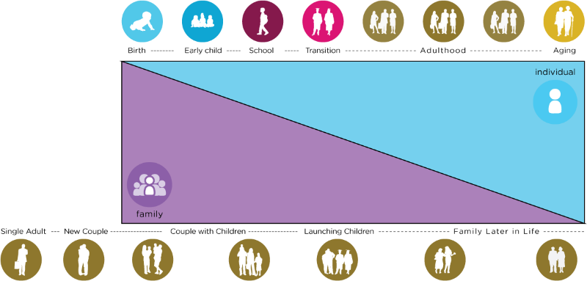
Family Life Cycle
Life Stages and
Individual and Family Cycles
Individual Life Stages
Notes:
Have to consider the individual’s stage of life, but also where other family members are in their lives. Are the parents aging? Are the siblings raising their own families? Is a sibling going away to college?
Stages – what happens in early or any stage, affects the stages to come.
Stages – what happens in early or any stage, affects the stages to come. You have them for only a very short time in their lifespan, but what happens in those years can have profound effect on future (adult) years!
*45 Year old PWD – parent is 65 or older and might be caring for their own elderly 95 year old parent!
*12 year old with autism – also has a new baby in the house.
Consider the person you support in the context of their whole family dynamic!

Slide 37






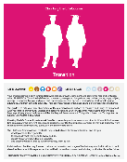
Life Stages: Think Across Generations
Age | 0-5 | 6-18 | 19-64 | 65
Total MO Population | 362,650 (6%) | 1,045,641 (17.3%) | 3,747,386 (62%) | 888,537 (14.7%)
Approx. DD (1.58%) | 5729 | 16,521 | 59,209 | 14,038
Notes:
what happens at early stages affects all the stages to come!
Where are people the longest?

Slide 38






Life Experiences and
Life Transitions
Chores and allowance
Summer jobs, babysitting
Learning to say “no”
Making Mistakes
Playing sports or an instrument
Birthday parties with friends
My parents have passed away, what do I do?
Scouts, 4H, faith groups
Parents Turn 65
Medicare & SSDI
Transition planning
Living Adult Life
Turning 18. Leaving school at 18 or 21
Leaving Early Childhood/ enter school
Getting New Diagnosis
“Anticipatory Guidance for Life Experiences”
Notes:
Life experiences – are how we get ready for the next phase – having chores as a child helps prepare you for employment. Having an allowance helps you learn about money (and making mistakes with money). Learning to say NO helps the person learn to protect themselves.
ANTICIPATORY GUIDANCE—especially at times of transition. Doctors do it all the time.
IE- we don’t start talking about Employment until age 14! But we can nudge people at age 2 or 5 or 10 – chores, summer job, volunteering, asking child what they want to be, learning about lots of options
Show them the LC Experiences booklet – talk about how people might use it.
SAFETY – people don’t stay safe because someone has always protected them. They need to learn skills!
Think beyond systems transitions ONLY

Slide 39






Life Experiences = Life Outcomes
Experiences at age 65
What We Want
Friends, family,
enough money,
job I like, home, faith, vacations, health, choice, freedom
Experiences
at age 13
Experiences
at age 5
What We DON’T Want
Notes:
Put an X above the pink icon –on the line – age 13
What kind of life experiences were you having at age 13? What were you doing, where were you going?
NEXT – put an x at age 5
THEN – put an x at age 65 – what do 65 year olds do?
YOU Lived thru these same life stages (or you will). Parents lose perspective – think they need a special book for everything. Help get confidence back – they know what to do! Talk about HOW to use the booklet—SC focus on a lifestage before a meeting; ask what they are struggling with or worried about the most; work from there with the booklet. ANTICIPATORY GUIDANCE!!!
Activity 5: Life Experience large group discussion (flip chart – draw trajectory arrow and boxes) (5 minutes)
What were you doing at age 13 (good and bad)?
Prompts: Babysitting, sleepovers, being naughty, involved in sports, music, church, band, Favorite teacher/mentor, boy crazy, sneaking out, etc. Record answers in middle of trajectory line on flip chart
What were you doing at age 5?
Prompts: Kindergarten, chores? Caregivers (family, neighbors, day care), Playing outside, Sunday School,
Record answers on left portion of trajectory line

Slide 40
Adapting and Accommodating
Life Experiences
What adaptations can you make for a 13-21 year old?
What I Want
What I DON’T Want
Discuss at your table and record your responses on your worksheet.
Notes:
Think about adaptations and accommodations so person/child can have same/similar life experiences of others that same age.

Slide 41
Experiences and Opportunities
Vision
Expectations
Opportunities
More Possibilities
Experiences
Notes:
Effect of opportunities and experiences. Think about the HCBS waivers -- Mo has only had since 1986, but it’s already undergoing major policy changes. We can’t just stay the same and not adapt and move forward.
LIFE Outcomes don’t happen without life experiences – real life experiences!

Slide 42
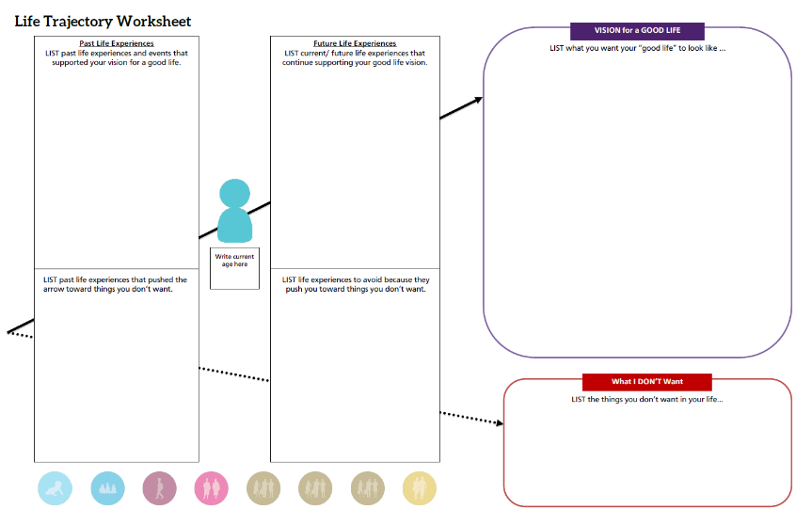
Impact of Life Experiences
Notes:
Holistic view of person – their past experiences and what they are working on now and in the future to achieve their good life and avoid the things they don’t want

Slide 43
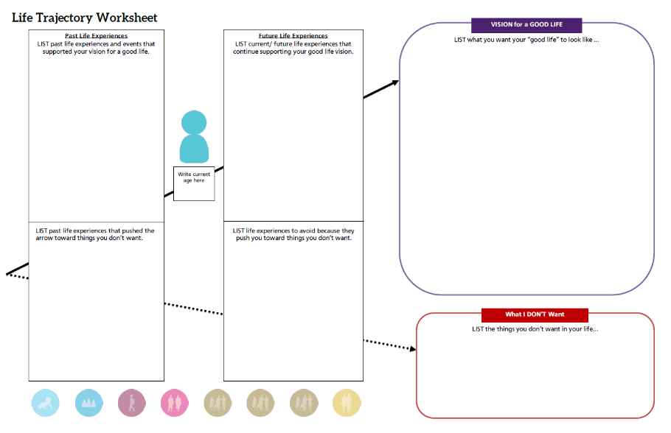
Ben’s Life Trajectory
Chores; boy scouts;
School inclusion/circle of friends;
Birthday parties;
Riding bike;
Family vacations;
Church youth group; Debit card;
Football manager; Homecoming king; Volunteering
High School diploma
Family and friends
Girlfriend
Vacations
Concerts; WWE; Nascar
Tattoos
Money; job or my own business
Volunteer at fire station
Being Tiger football manager
Church
Healthy & fit
Good food; Pepsi
Basketball
Royals baseball
Staying active
Volunteer at fire station; Find more volunteer ops; Workout regularly;
Keep in touch w/ friends; Increase alone time;
Go out with friends; Spend daytime hours out of the house;
Explore micro enterprise;
25
Special education low expectations;
Para glued to Ben’s side; Pressure to segregate; Medication side effects;
Scoliosis;
Seizures;
Physical barriers;
Sitting at home watching TV all day;
Rely on paid supports;
Gain weight;
Eat unhealthy foods or drink too much Pepsi (caffeine);
Poor health, heart disease, diabetes; Poverty/no money;
Guardianship; institution/group home; Segregation/isolation; being lonely
Being treated differently;

Slide 44
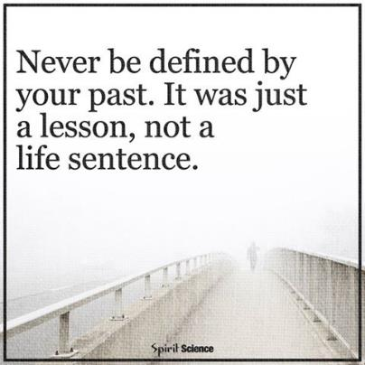
Dignity of Risk and Mistakes
Friends, family,
enough money,
job I like, home, faith, vacations, health, choice, freedom
Poverty, loneliness, segregation, restrictions, lack of choice, boredom
Notes:
People need to be allowed to take risks and make mistakes – and not pay for it forever. We all make mistakes and move past it – but PWD often are labeled or restricted for life if they make even a simple mistake. “fire-starter” “sexual predator” “can’t use the internet”
Person doesn’t learn to STAY SAFE if someone is always protecting them from everything!

Slide 45
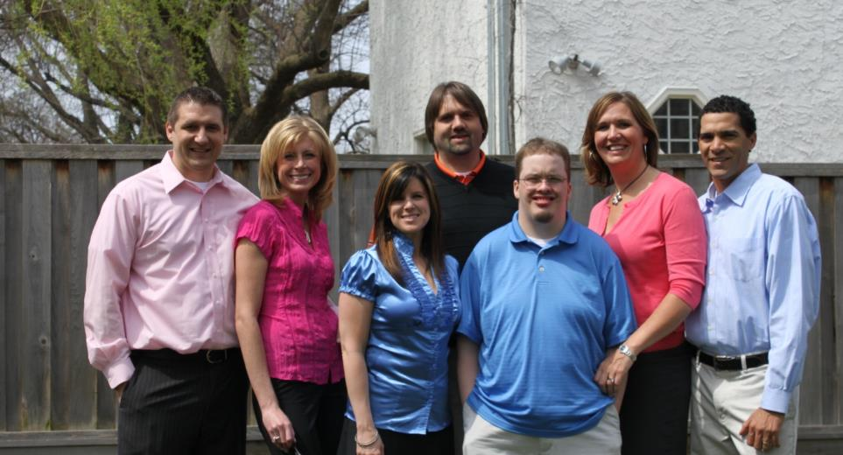
Life Domains, Life Outcomes and Life Possibilities

Slide 46






Achieving Outcomes for
Connected Life Domains
Daily Life and Employment
(school/education, employment, volunteering, routines, life skills)
Healthy Living
(medical, behavioral, nutrition, wellness, affordable care)
Community Living
(housing, living options, home adaptations and modifications, community access, transportation)
Safety and Security
(emergencies, well-being, legal rights & issues, guardianship options & alternatives )
Social and Spirituality
(friends, relationships, leisure activities, personal networks, faith community)
Citizenship and Advocacy
(valued roles, making choices, setting goals, responsibility, leadership, peer support)
Notes:
Explain each domain. They are all interrelated. The service system tends to want to focus only on health and safety.
Cocktail party conversations…
Quality of life areas!!

Slide 47
Tool for Developing a Vision
Notes:
Drill down – get more specific in each domain

Slide 48
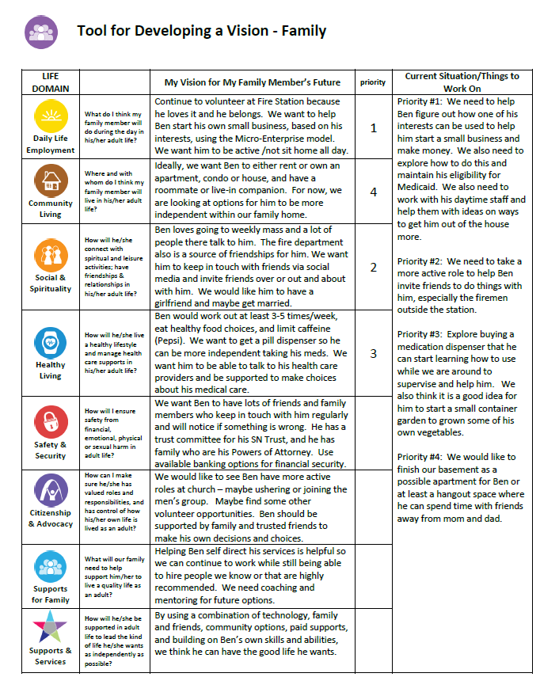
Ben’s
Tool for Developing a Vision
Getting more specific in each life domain
Notes:
Taking Good Life to next level – drill down and go into details about what family thinks and person

Slide 49
Looking at Life Possibilities
Innovative | Very new or undiscovered
Islands of Excellence | Exists in a lot of places but not everywhere
Traditional Options | Services that have existed for a long time
Notes:
Removes value judgments and blame
Not a continuum, but current or historical options
TELEPHONE analogy

Slide 50

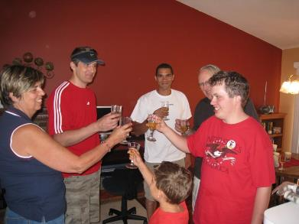
Where I Live
Housing Options
Innovative
Not Yet Discovered
Islands of Excellence
Own home Shared Living Space Co-op Environmental Adaptations Independent Supported Living
Traditional Options
Training Centers Intermediate Care Group Homes
Notes:
Settings RULE - We MUST separate where someone lives (housing) from Services. Eric’s various living arrangements – he would get “fired” from living in settings. Story about how one agency sent him to the hospital and said don’t send him back. NOW his name is on the lease. HE now has the power, the control – he can fire an agency, they can’t kick him out. The intent of the RULE is all about giving the control back to the PWD.

Slide 51

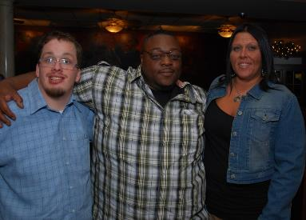
How I am Supported
Long Term Services & Supports
Innovative
A new possibility
Islands of Excellence
Remote Monitoring Assistive Technology Time banks Human-service coops Self-directed Services Respite Micro-boards Companion Model
Traditional Options
Staff hired by Provider
Notes:
Had to rethink how Eric was supported – went from 2 or 3 on 1 to living in companion model, living as a family member/friend. He’s happy and behaviors have all but disappeared.

Slide 52

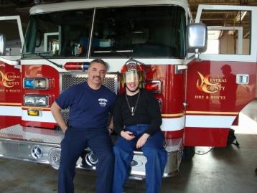
What I do During the Day
Daily Life and Employment
Innovative
A new possibility
Islands of Excellence
Micro-enterprise College/Tech Schools Career Military Supported Employment Volunteerism AmeriCorps/VISTA
Traditional Options
Sheltered Workshops Day Habilitation

Slide 53
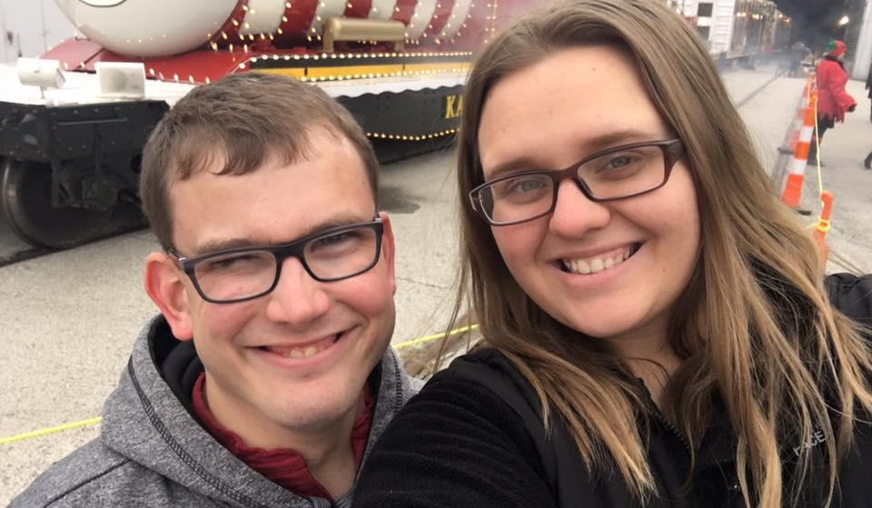
Individualized Supports to Achieve a Good Life

Slide 54

Three Types of Supports
Goods &
Services
(Day to Day, Medical, Financial Supports)
Discovery & Navigation
(Info and Training)
Connecting & Networking
(Talking to Someone that has been there)
Notes:
The 100% can have access to the 3 buckets - even if they never receive formal services
YOU don’t have to know everything or provide it – but you can refer them to someone that does. Every state has a family to family organization, and many have parent to parent networks.
Judy Chezik and MPACT story

Slide 55
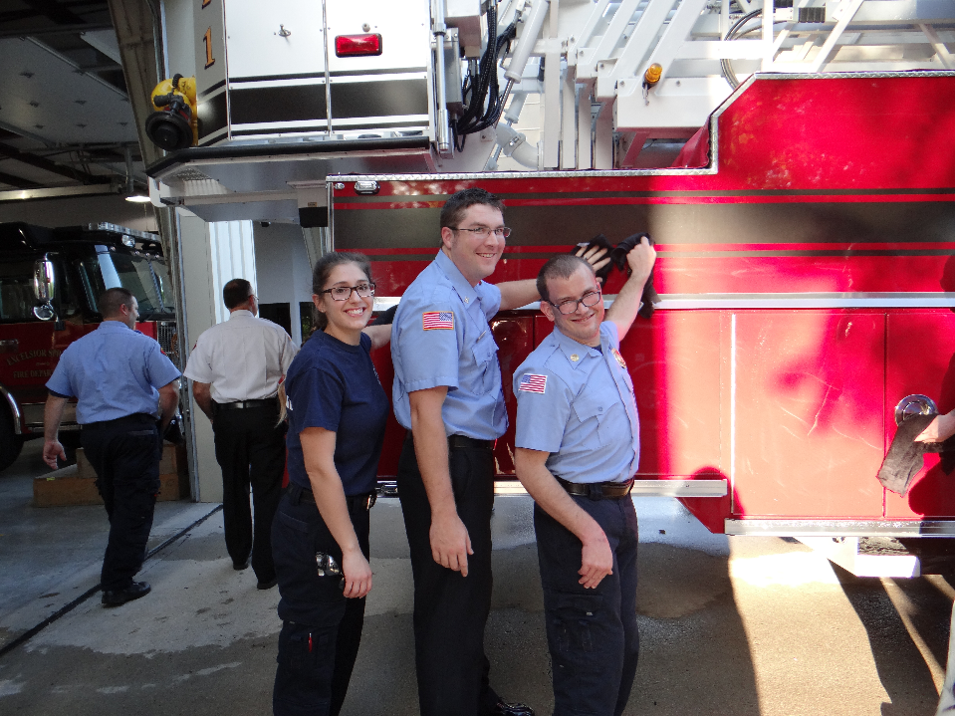
Integrated Star for Problem Solving & Exploring Options
Notes:
HOW do we get the supports needed for the GOOD LIFE???

Slide 56
Integrating Services and Supports
75%
People with I/DD not receiving formal DD services
25%
People with I/DD receiving formal DD services
100%
People with I/DD receiving integrated services and supports

Slide 57
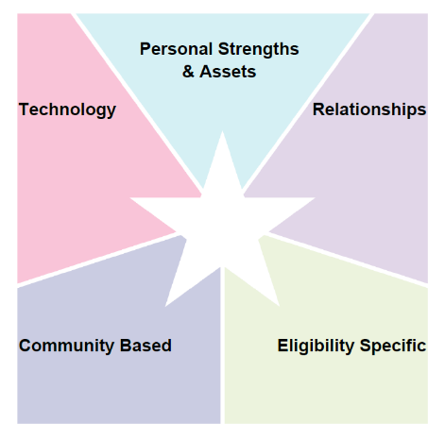
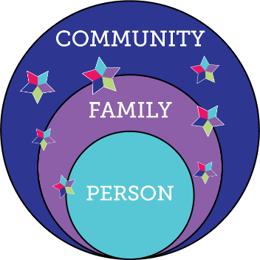

LifeCourse Integrated Supports STAR
resources, skills, abilities characteristics
i-pad/smart phone apps, remote monitoring, cognitive accessibility,
Adaptive
equipment
family, friends, neighbors, co-workers, church members, community members
school, businesses, church faith based, parks & rec, public transportation
SHS services, Special Ed, Medicaid, Voc Rehab, Food Stamps, Section 8
R
100%
Notes:
MAPPING
PROBLEM SOLVING
PLANNING LTSS
PLANNING ACTIVITIES
We ALL do this without even thinking about it

Slide 58
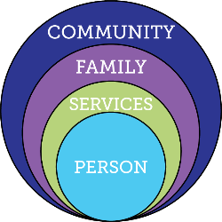

Focusing ONLY on Eligibility Supports
Friends, family, enough money,
job I like, home, faith, vacations, health, choice, freedom
Eligibility Supports
Poverty, loneliness, segregation, restrictions, lack of choice, boredom, institutions
Notes:
Story about family asking permission for their son (who doesn’t receive services for housing) to move into his own apartment
OATS bus -

Slide 59
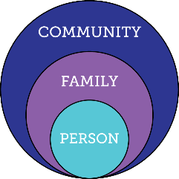

Relying ONLY on Family & Friends
Friends, family, enough money,
job I like, home, faith, vacations, health, choice, freedom
Relationships
Poverty, loneliness, segregation, restrictions, lack of choice, boredom, institutions

Slide 60



Daily Routine
Morning or Evening
Notes:
Activity 7: Integrated Supports Star large group discussion: Large 11x17 Star worksheet
Ask participants to call out the things they use to get through their day. IE: what types of supports do you use to get through your morning routine or evening routine? (5 minutes)
Record the things used to accomplish the routine on the flip chart or poster board as they call it out
IE: alarm clock =technology, Starbucks = community, meal with family = relationships, school buss – community, carpool – relationships, morning person: personal strength, etc.
Facilitate large group discussion, lead, nudge or pull them to the realization that we all use integrated supports every day?

Slide 61

Problem Solving:
Life Domain
Life Domain
Notes:
Write Life Domain in center
Activity 8: Integrated Supports Star table activity: large star work sheet titled Problem Solving by Life Domain Scenario (15 minutes)
Assign each table one of three separate scenarios:
Making friends
Learning to cook
Getting first job
Discuss the supports a person with SHCN could use to accomplish the task
One person record ideas on large star worksheet
Large group follow up – facilitate discussion
What types of things did you come up with?
Were there any innovative supports mentioned at your table?
TEACHING people to problem solve – NOT about filling out a tool but teaching the skills to problem solve!!!

Slide 62

LifeCourse Integrated STAR: Exploration & Discovery
Problem Solving specific issue or life domain
Mapping strengths and areas to focus on
Notes:
Use it like a bank you can pull from when problem solving or working on supports or activities.

Slide 63









Integrated Options
Support Stars

Slide 64






Eric’s Focus on Social and Spiritual
Happy, Funny and loving
Likes to help people
Likes to try new things
Police cars, tow trucks, fire engines and racecars
Golf Cart
See his girlfriend more
Connect with his family
Spend more time with friends
Scouts
Red Robin
Race Tracks
Companion Supports
day-to-day
I-pad
Smart Phone

Slide 65

Domain Specific
Daily Life: Focus on Employment

Slide 66
Safety and Security: focus on
Supported Decision Making

Slide 67

Ben’s Safety & Security Star
Focus on Supported Decision Making
Notes:
Now and future – succession planning

Slide 68

HEALTHY LIVING
PROBLEM SOLVING FOR SPECIFIC ISSUE OR GOAL
Example:
Losing Weight

Slide 69

Problem Solving:
Employment is decreasing from 30 to 15 hours a week
Parents are worried about who will provide supports during 15 hours not working
Concerned about losing eligibility of services

Slide 70


Problem Solving Getting More Involved in Community

Slide 71


Problem Solving:
Looking for an Apartment

Slide 72

LifeCourse Star to Calendar

Slide 73

Mapping Current Supports

Slide 74


Ben’s Services and Supports
Able to stay home alone for up to an hour; has & can use i-pad;
i-pad when home alone; digital watch
Mom, Dad, Matt, Zac, Ali, Chad, Ericka, Roy, Carol, Nick, Spohn,
Ben’s Services & Supports
Firemen at ESFD; coaches & staff at ES high school; Omni bus;
DDD Self-Directed waiver PCA staff; Medicaid; Special Needs Trust
Notes:
Mom and service system figuring out oversight – who and how Ben is being supported 24 hours a day

Slide 75
Ben’s Life Activities
Can stay home alone for up to one hour
I-pad to watch WWE network and music videos; facebook
Mom, Dad, Matt, Zac & Ali; firemen friends; Nick, Spohn, Mike,
Ange, Chad, Ericka & twins
Ben’s Life Activities
Fire Station, Wal-Mart, movies, bowling, Sonic, Price Chopper, Church, High School, IHD
Paid staff thru SD waiver help with activities, ADL’s & access community; therapeutic riding
Notes:
Family and staff figuring out what Ben does during the day (and evening).

Slide 76

Calendar to Star/Planning

Slide 77

Calendar to Star/Planning

Slide 78
Questions or Reflections

Slide 79






Notes:
First show the person,
Then show the family,
then bring up the domains
And then the buckets
And then the outer layers
All these things work together to make a good life.

Slide 80




Life Course Case Studies
Notes:
EVERYBODY in ES knows Ben! You can’t walk thru Wal-Mart without half dozen people talking to Ben.
He learned to ride the Omni bus as part of his transition plan, and he would go to WalMart and Price Chopper and use his debit card to make purchases from a list.
“live in the basement”
Spending some time alone
Our house in Ben’s Special Needs Trust
Shared Living

Slide 81


Small Table Scenario Activity
Notes:
Use what you know
Think about questions you’d need to ask or what you need to discover
CHALLENGES
HOW did you get started???

Slide 82


Elizabeth age 5

Slide 83

Elizabeth’s Life Trajectory

Slide 84

Elizabeth’s
Integrated Star:
Mapping Supports
:

Slide 85
Scenario #1: Peter
Peter is a 65 year-old with cerebral palsy as well as a cognitive disability, living at home with his 85 year old mother. His father is deceased. He has always lived at home and been cared for by his parents. He doesn’t have a guardian. His mother has recently had some significant health issues and is not expected to live much longer. He enjoys listening to Jazz and watching old movies. His favorites are musicals and anything with Bette Davis. He has siblings, a sister who lives in the same town and a brother who lives an hour away. He has never had any experience using a computer or other modern technology. He can read simple passages, but really cannot write due to his CP. He can walk short distances but tires easily and sometimes uses a wheelchair. He is sometimes shy around people at first, but eventually is friendly and engaging. He doesn’t leave the house much other than going to church on Sundays or going with his mother to the grocery store.

Slide 86
Scenario #2: Blake
Blake is a 12 year old who has complex medical needs, including diabetes, and needs opportunities for physical activities to get fit and stay healthy. His family can’t afford to pay for extra-curricular activities. He likes Minecraft and riding his bike. His home is close to a busy street which makes it hard to ride his bike outdoors. He is included in general education classes at school and has a few friends, but hasn’t had much opportunity to spend time with them outside of school. He sometimes has trouble following his diet and his poor choices make his blood sugar fluctuate and complicate his diabetes.

Slide 87
Scenario #3: Sara
Sara is a young adult with autism and is graduating from high school in a few months. She wants to have a job after she graduates, but has no work experience. She doesn’t drive a car. Both parents work outside the home and can’t afford to quit their jobs. She loves watching Animal Planet and Discovery Channel, especially Mythbusters and How It’s Made. She recently started a blog connecting her to others who enjoy watching these shows. She also enjoys being around animals of all kinds, but has never had a pet. She wants to have friends and relationships, but has a hard time making friends. She gets frustrated easily and sometimes loses her temper or has a meltdown.

Slide 88
Questions or Reflections

Slide 89

Using LifeCourse for Specific Issue

Slide 90

Peyton’s Plan for Inclusion in
School
Using the LifeCourse Tools to Transform the Way the School Thinks about Inclusion for Peyton
Notes:
How the Story Began: Peyton
Family wants Peyton to attend the neighborhood school with his brother and his school age peers
School believes that Peyton will be best supported in a next year in a segregated setting, in a different building which does not have students his age
During the IEP meeting, the school and parent became grid-locked on a what more inclusive day could look like for Peyton (he was not included in homeroom, lunch, specials or other general education class)
Two weeks later, Mom brought Peyton’s trajectory, integrated star and weekly schedule to the follow-up IEP. The school better understood what she wanted and have made more concrete strides at meeting his inclusion needs.

Slide 91

Peyton’s Good Life Trajectory
Friends
Family
Productive Employment
Happiness
Living Independently
Meaningful Relationships
Love
Community Involvement & Inclusion
Sheltered Workshop
Group Home
Isolation
Dependency on paid supports
Lonely
Unhappy, unproductive, bored
Poverty

Slide 92


Peyton’s Integrated Supports

Slide 93

Self-Advocates and Families
Using LifeCourse

Slide 94

Jessica’s Transition Plan

Slide 95

Jessica’s Trajectory

Slide 96

Vision for a Good Life

Slide 97

What Jessica Doesn’t Want

Slide 98

Elementary School Trajectory
Notes:
This is a trajectory made by a mom after interviewing her 9 year old son about school.
Point out some of the cool concepts that come to mind

Slide 99

Support Coordination
Tools for Exploring and Planning with People with Disabilities and their Families
Notes:
TOOLS – might just use to take NOTES; eventually will guide your thinking and conversations. Person or family doesn’t have to fill out or even know you are using the tool. Can use very broadly or very specific to a need or situation.

Slide 100


LifeCourse School Portfolio
Abilities First
One Page School Profile
Notes:
Worked with UMKC-IHD UCEDD/MoF2F to revise the LifeCourse general portfolio into a School Portfolio

Slide 101


Max’s School Portfolio
Abilities First
One Page School Profile
Notes:
MAX – School Profile – Expand on how this helped Max
- - Collaboration and Planning

Slide 102

Adult Employment Trajectory

Slide 103

Cognitive Accessible Trajectory: Individual

Slide 104

Cognitive Accessible Trajectory:
Family

Slide 105



Bentley – age 5

Slide 106

Support Coordinator
Planning with person

Slide 107

Support Coordinator
Planning with Staff

Slide 108


Tony –
7 years old

Slide 109


John’s Vision for Good Life:
Developed at Annual Person Centered Planning Meeting with Support Coordinator

Slide 110

Organizations & Systems

Slide 111

The Arc StL
Problem Solving for
Info and Referral

Slide 112


Draft ISP Template

Slide 113

Organization:
Hiring New Support Coordinators

Slide 114

Team within an Organization

Slide 115


Organizational Strategic Thinking:
Evolving Day Habilitation Services

Slide 116


Organizational Strategic Thinking:
LOQW and PCS
Notes:
Cyndi
Why did you use the life domains? What do they mean? What do they help you understand or organize?
Its back to our light bulb moment…. We became comfortable with the framework…. It just naturally made sense to us… that hey… we could use this same idea and apply it to any type of planning…. Not just individuals.
So we did! We used the life domains and the guiding principles of the Charting the LifeCourse framework to ensure we were “Remembering Why We Do What We Do”…. Back to that lightbulb moment.
Life is a Journey – Our lives are not static, they change everyday.
Its all about Vision – Anything is possible with the right vision and focus.
Everything is connected – What you do today affects your life in the future.
Our overall compass for people and their families is “Quality of Life”.
(I don’t have those little icons handy… but they should really go with these if you actually put those things in the slides.)
It isn’t much of a stretch to make those things apply to an organization right???
So keeps us on point… etc. The little icons actually being added in are really just visual reminders…… we tend to be pretty visual people and something about having those right there helps us focus.

Slide 117
Organizational Change:
Website organized around LifeCourse

Slide 118

Mo DD State Agency
LifeCourse Focus
New Mo Quality Outcomes
ISP Guidelines
Service Coordinator Manual

Slide 119







LifeCourse
Educational Materials
LifeCourse
Tools
Lifecoursetools.com
Notes:
TOOLS – might just use to take NOTES; eventually will guide your thinking and conversations. Person or family doesn’t have to fill out or even know you are using the tool. Can use very broadly or very specific to a need or situation.

Slide 120
Integrated Options
Support Stars

Slide 121






Focus on…. Life stages

Slide 122






Life Domain & subtopic guides

Slide 123

Coming soon
Guide focused on supporter/caregiver

Slide 124

Ways to Get Involved:
-Webinars
-CoP Listserv
-Website Links supportstofamilies.org lifecoursetools.org mofamilytofamily.org

Slide 125

Life isn’t about how to survive the storm, but how to dance in the rain.
-unknown

Slide 126
Questions, Reflections and Discussion

Slide 127
Contact Information
Sheli Reynolds
reynoldsmc@umkc.edu
Barb Brent
bbrent@nasddds.org

Slide 128







THANK YOU!!!
Please complete your evaluations

Slide 131



National Community of Practice on Supporting Families
Project Goal
To build capacity through a community of practice across and within States to create policies, practices and systems to better assist and support families that include a member with I/DD across the lifespan.
Funded by
National Partners
Notes:
Framework started with Mo F2F stakeholders. Plain language, not systems jargon.

Slide 132

LifeCourse Integrated STAR: Exploration & Discovery (Mapping)

Slide 133


Shaylee’s Integrated Services and Supports
curious, sense of humor, friendly, loyal, ability to focus, organized, stands firm in her beliefs, compassionate
Family, Support group families, neighbors, 4-H club members, Advocates, Librarian, Pastor, Sunday School Teacher and Youth Leaders, Pharmacist, Doctor and Nursing staff, Homeschool families, bowling league members and owners of the lane.
ID tag/jewelry Cell phone alarm clock microwave
Timer
computer kindle or I-pad daily schedule
SHAYLEE’S
service coordinators, insurance coverage, diagnosis and testing, age, location, living arrangements, therapies, income/SSI benefits or other financial aid, doctors, nursing, and specialists working as a team WITH her
Church/Sunday School/Youth Group, Parks and Recreation, YMCA, Bank, Library, Grocery Store, Pharmacy, Doctor Office, Taxi, Bus or Oats Transportation, Support and Advocate Organizations, Homeschool Support Groups

Slide 134


Izaac’s Integrated Services and Supports
Extremely outgoing, funny, natural leader, cute, thick-skinned, nonchalant,
Kindle
Wii
X-box
You tube
Scooter
Vent/trach
Life Support Equipment
Family, neighbors, school friends, nurses, church, cheer, tae kwon do, dog
Izaac’s
Athlete’s Plus Cheer
Tai Kwon Do
McAllister’s family night
Church
School
Service Coordination
Nursing
Adaptive Equipment
Medical Supplies
Insurance

Slide 135

LifeCourse Integrated STAR: Support & Service Planning

Slide 136

LifeCourse Integrated STAR:
Life Activities

Slide 137

Domain Specific
Daily Life: Focus on Employment

Slide 138


Domain Specific
Safety and Security:
Focusing on Supports Beyond
Legal Guardianship

Slide 139

About Jane
Mom of 3 sons, one with a developmental disability
Partners in Policymaking Graduate
Community Inclusion and Field Research Specialist
  National Community of Practice on Supporting Families Staff
  Missouri Family-to-Family HIC staff
  Alternatives to Guardianship Trainer

Slide 140
About Sheli
Sibling of three brothers, one who is 32 year old with developmental disability
Director of Individual Advocacy and Family Support, UMKC UCEDD
  Supported the Self-Advocacy Movement for 12 years
  Director of Mo Family-to- Family Health Info Center
  Co-Director of National CoP on Supports to Families

