Slide 1

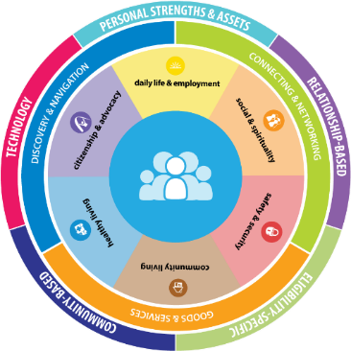
Supporting “Good Lives” for Persons with Developmental Disability and Their Families
Mary Lee Fay, National CoP, NASDDDS
Sheli Reynolds, National CoP, UMKC-IHD, UCEDD
July 9, 2015

Slide 2
About Us….
Mary Lee Fay
  Formerly Director of State Developmental Disability Services in Oregon
  NASDDDS, Co-Principle Investigator CoP and National Core Indicators
Sheli Reynolds
  Sibling of brother with developmental disability
  IHD, Mo UCEDD, Director of Individual Advocacy and Family Supports
  Co-Principle Investigator CoP

Slide 3
Outcomes for Today
Learn about and apply the LifeCourse framework and tools to assist with Discovery and Navigation for information and planning
Explore Connections and Networks for supporting others through interactive activities and discussions
Identify Integrated Supports strategies for enhancing the trajectory towards a good life

Slide 4
Setting the Stage?
Why are we talking about developmental disability, families and NWD/ADRC?

Slide 5








Project Goal
To build capacity through a community of practice across and within States to create policies, practices and systems to better assist and support families than include a member with intellectual and developmental disability across the lifespan.
CT
DC
MO
OK
TN
WA

Slide 6
ALL: Public Health Framework
Medical System
Flu Shot
Hand Washing
Anti-Bacterial Soap

Slide 7
Constructing Universal Strategies for Supporting Individuals with Disabilities and Families Across the LifeCourse
Long Term Services and Supports
-Family and Self-Advocacy Networks
-Aging and Disability Resource Centers
-No Wrong Door Initiatives
-Area Agencies on Aging
-Parent Training Info Centers for Education
-United Way 211
Community Resources

Slide 8
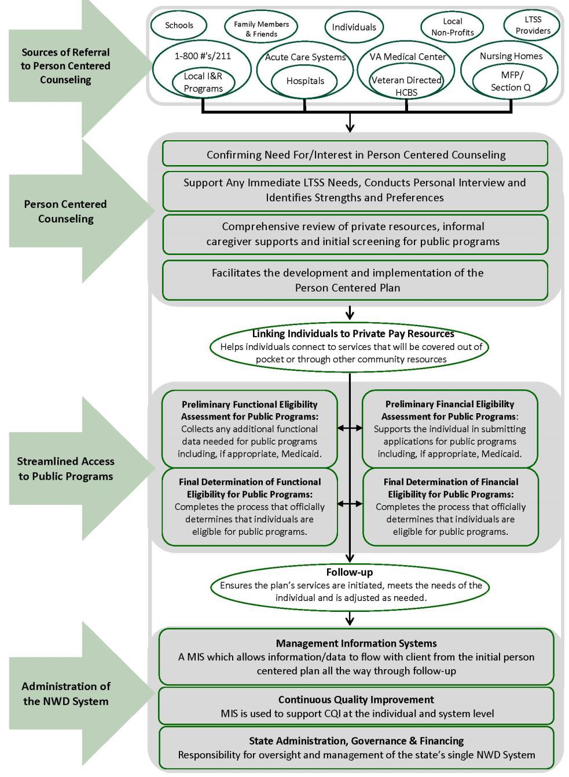
No Wrong Door SYSTEM
Focus of
CoP Supports to Families and
DD System:
Support Coordination
Person Centered Thinking, Planning, and Facilitation
Family Navigation and Family Neworks
LifeCourse Framework and Tools
Responding to new CMS HCBS rule
Focusing on Front Door of DD Services
Developmental Disability Field has been evolving from an institutional based to system to a person centered system for many years

Slide 9
Focusing on All
Focusing on Serving Persons with Developmental Disability and their Families

Slide 10
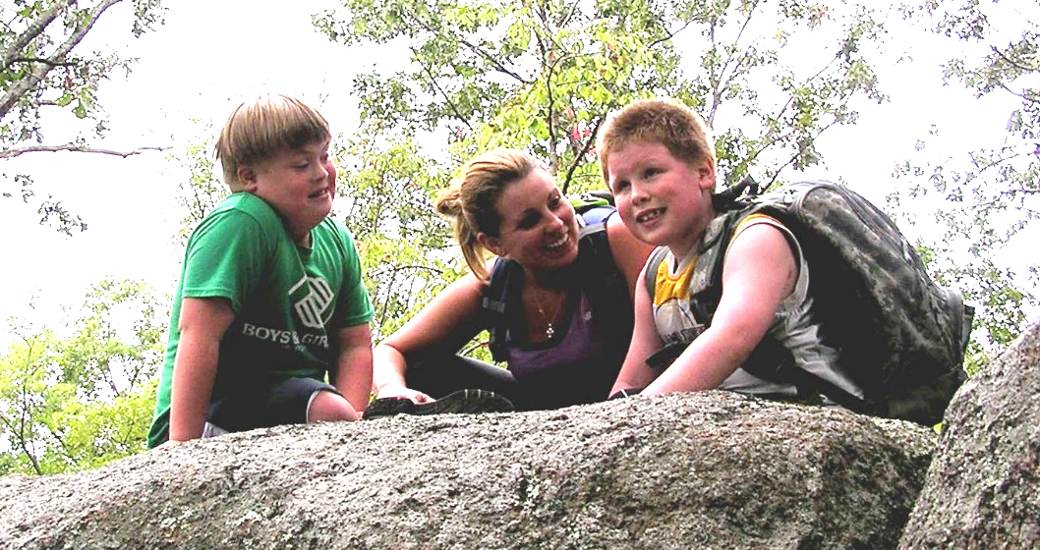
Focus on “ALL”
100%
ALL individuals and their families are considered in our values and vision.
(Family is defined by the Individual)

Slide 11
1 in 5 Americans with Disability
9.4 million individuals have difficulties with activities of daily living (eating, bathing, dressing)
      5 million required assistance
  15.5 million individuals have difficulties with instrumental activities of daily living (housework, phone, meal preparation)
  12 million required assistance
  (Americans with Disabilities 2010, U.S. Census Bureau)

Slide 12
What is Developmental Disability?
Federal Definition of Developmental Disabilities
According to the Developmental Disabilities Act, section 102(8), "the term 'developmental disability' means a severe, chronic disability of an individual 5 years of age or older that:
1. Is attributable to a mental or physical impairment or combination of mental and physical impairments;
2. Is manifested before the individual attains age 22;
3. Is likely to continue indefinitely;
4. Results in substantial functional limitations in three or more of the following areas of major life activity; i. Self-care; ii. Receptive and expressive language; iii. Learning;
Iv. Mobility; v. Self-direction; vi. Capacity for independent living; and vii. Economic self-sufficiency.
5. Reflects the individual's need for a combination and sequence of special, interdisciplinary, or generic services, supports, or other assistance that is of lifelong or extended duration and is individually planned and coordinated, except that such term, when applied to infants and young children means individuals from birth to age 5, inclusive, who have substantial developmental delay or specific congenital or acquired conditions with a high probability of resulting in developmental disabilities if services are not provided."
Notes:
ALL individuals with disabilities and families are considered in our values and vision.
(Family is defined by Individual)

Slide 13
Who receives DD LTSS?
All 4.9 Million people with developmental disabilities
25%
75%
National % Receiving State DD Services
Unaware of disability specific services
Do not want disability specific services
Have a diagnosis but don’t meet “eligibility criteria” in that state system
Notes:
ALL individuals with disabilities and families are considered in our values and vision.
(Family is defined by Individual)

Slide 14
Individuals in DC with I/DD
9,632 individuals estimated to have Developmental Disabilities*
23%
(2,228)
77%
(7,404)
Receiving DDS Services
Inside the State System
Living independently or with family | 796
IDD Waiver | 1,655
ICF/IDD | 330
Waiting List | 0
Not Receiving
DDS Services
*Based on 1.49% prevalence, S. Larson, University of Minnesota (2013)

Slide 15
Where Adults with I/DD Live
89% of People I/DD are Supported
Outside of Formal Residential Supports
Larson, S. A., Lakin, K. C., Anderson, L., Kwak, N., Lee, J. H., & Anderson, D. (2000).

Slide 16
Understanding the Field of DD
Past, Present and Future of Supporting Individuals with Developmental Disability and their Families

Slide 17
Movements Shaping DD Supports
1950s Mom------------Parent-----Family Movement
1970s Self-Advocacy and Independent Living Movements (Not about me, without me)
2000s Siblings Movement
1960s Medicaid and Medicare Established
1980s Medicaid Waiver (Community Supports)
2010s Affordable Care Act
Community
Family
Person with Disability
1970s Rehab Act: 504 Plans
1975s Education for All Children
1990s IDEA and ADA
2000’s Community
and Society

Slide 18
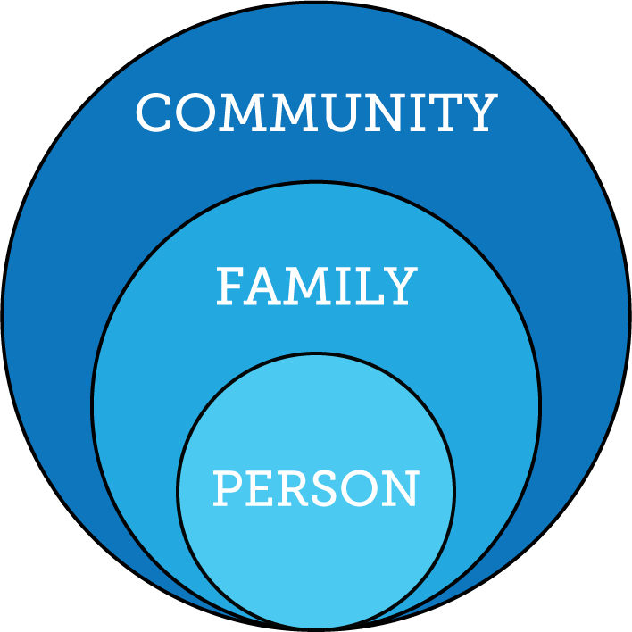
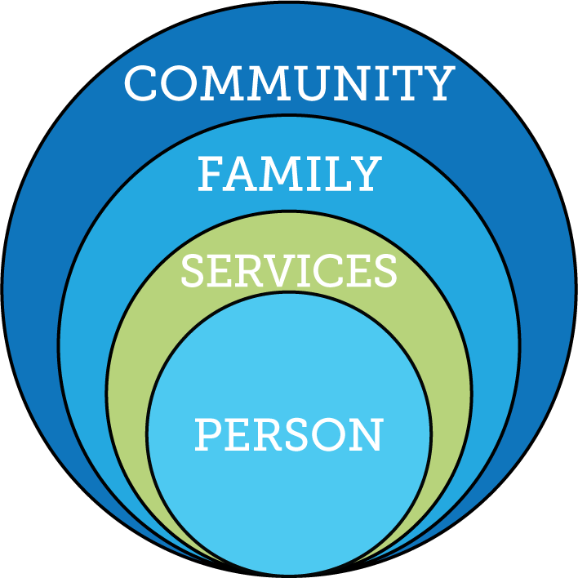
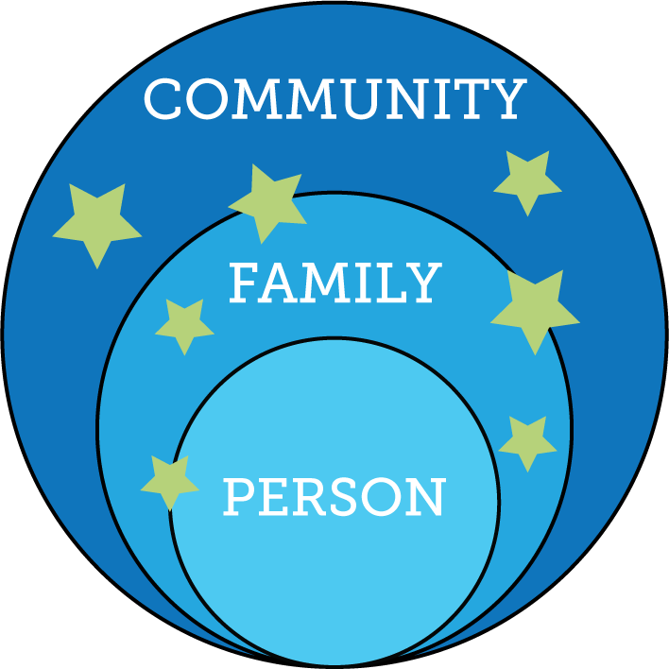
Services and Supports are Evolving

Slide 19

Services and Systems
that Focus on the Person
Within the Context of Their Family
(Regardless of where a person lives)

Slide 20
History of the Role of Family
Era | Understanding of Family | Disability Services
1800s- | Moral blame assigned to parents | Removal from Society
1900s | Child damaged families | Removal from Family
1950s | Burden of Caregiving | Specialized Therapeutic Congregate Services
1980s | Families seen as system Positive Coping | Community Group Residential Supports
1990s | Families support children to remain in their home for as long as possible | Family Support programs for children living at home

Slide 21
History of the Role of Family
Era | Understanding of Family | Disability Services
2010s | Families adapt, accommodate and are resilient Recognize that there are additional emotional, physical and financial realities | -Family is a main constant in the lives of persons with disability -Families play significant role across the lifespan regardless of service provision -Families may need supports for the different roles they play in the lives of their family member

Slide 22
What we know about current realities for pressures for change?
Community
Family
Social and Medical Services
Person with Disability
Demand for Services
Expectations, Values, Culture
Policies and Budget
Evidence Based Practices
Language and Words
Notes:
Key Federal Policy:
Developmental Disability Act
Individuals with Disabilities Education Act
Family and Medical Leave Act
Lifespan Respite Act
Older American’s Act
Key Federal Initiatives
Medicaid Money Follows the Person
SSA Ticket to Work
Aging and Disability Resource Centers
HHS Community Living Initiative
Other Key Initiatives:
National Governors Association initiative “A Better Bottom Line: Employing People with Disabilities”
Key Federal Policy:
Developmental Disability Act
Individuals with Disabilities Education Act
Family and Medical Leave Act
Lifespan Respite Act
Older American’s Act
Key Federal Initiatives
Medicaid Money Follows the Person
SSA Ticket to Work
Aging and Disability Resource Centers
HHS Community Living Initiative
Other Key Initiatives:
National Governors Association initiative “A Better Bottom Line: Employing People with Disabilities”

Slide 23
“A Good Life for All”
A LifeCourse Framework to Guide
NWD/ADRC Services

Slide 24
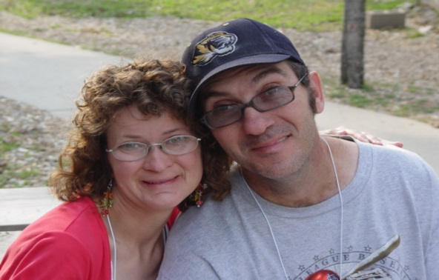
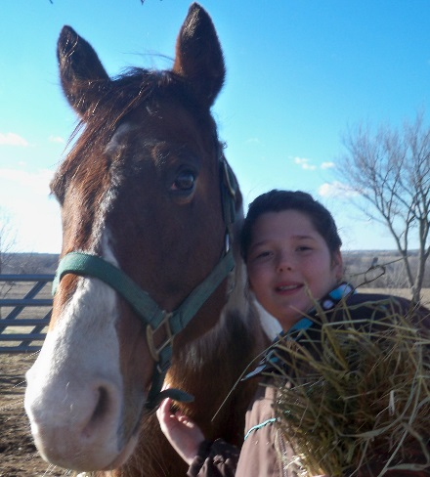
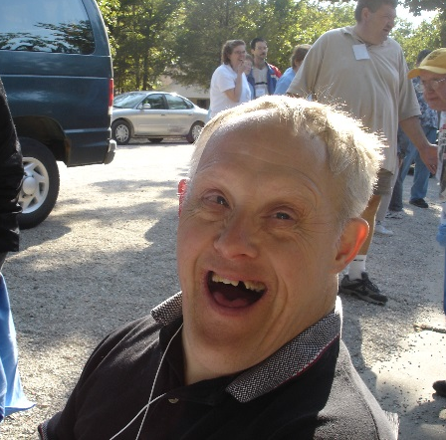
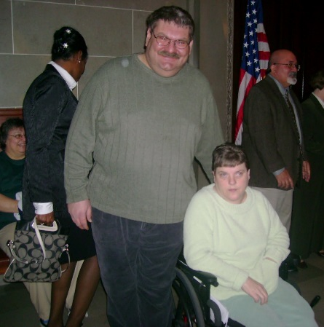
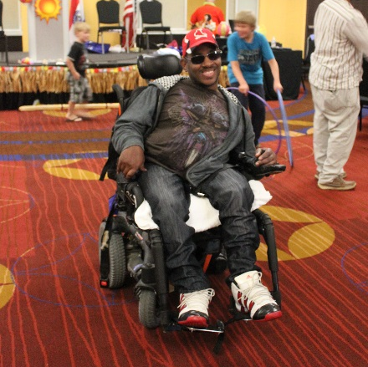
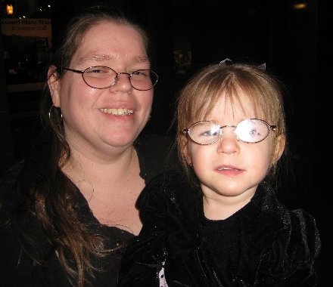
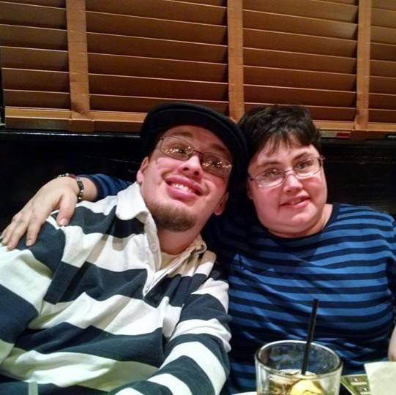
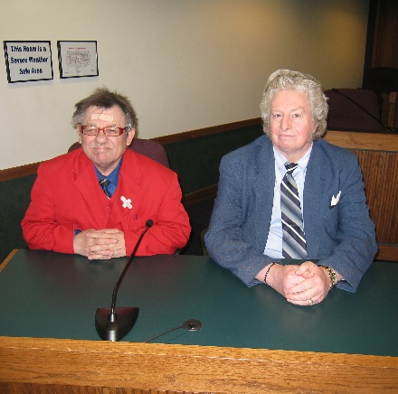
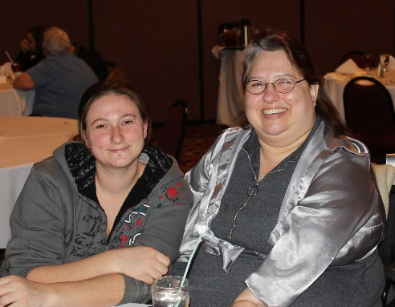
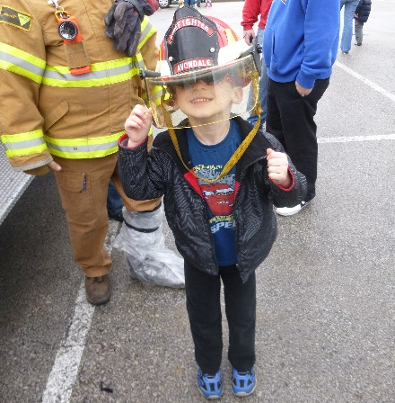
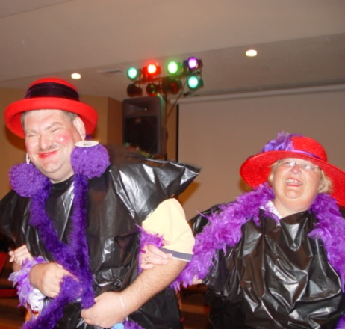
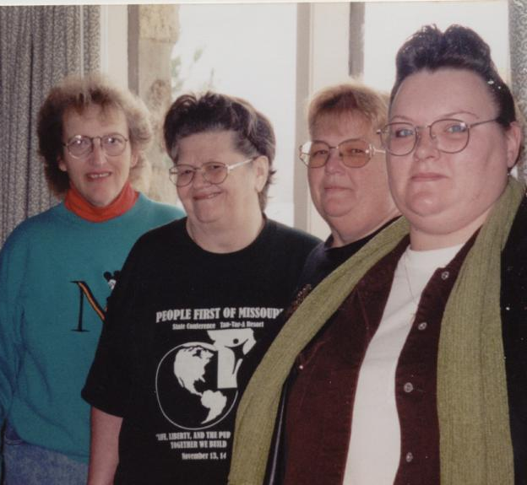
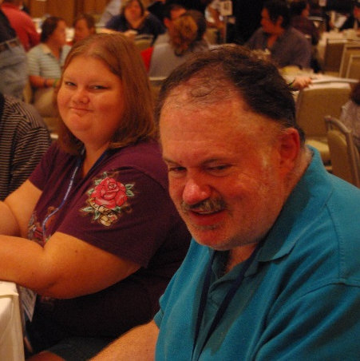
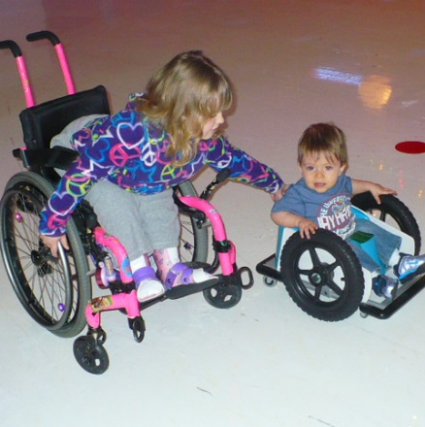
All people have the right to live, love, work, play and pursue their
dreams in
their community.
Notes:
RACHEL:
Before we get started, we want to share with you the core belief that guides all of the work that we do at Missouri Family to Family.
KATIE:
Read the blue box.

Slide 25



“Good Life for All ”
The Individual will achieve self-determination, interdependence, productivity, integration, and inclusion in all facets of community life
Families will be supported in ways that maximize their capacity, strengths, and unique abilities to best nurture, love, and support all individual members to achieve their goals

Slide 26

Defining FAMILY
Family are those people who…
Consider themselves a family (whether or not they are related by blood or marriage) and support and care for each other on a regular basis
This is not dependent on where they live.
(Turnbull and Turnbull, KU Beach Center)

Slide 27
Lifelong Impact of Family on Individual
Biologically: Likes, dislikes, skills, abilities
Socially: Family and friend network, connection with community members
Environmentally: Neighborhood, socio-economic, education
Policy:
Dreams, Aspirations,
House rules, cultural rules, expectations

Slide 28
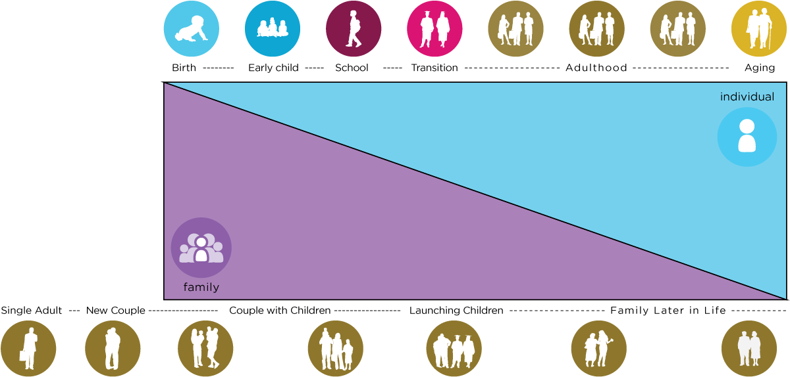
Family Life Cycle
Recognition of Individual
and Family Cycles
Individual Life Cycle

Slide 29
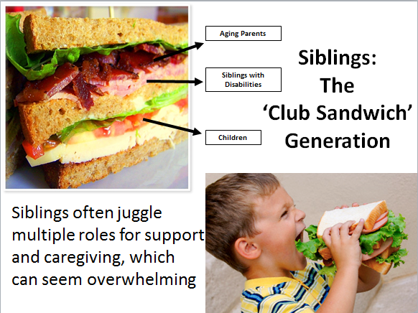
Notes:
Katie

Slide 30


Reciprocal Roles of ALL Family Members
Caring About | Affection & Self-Esteem
 | Repository of knowledge
 | Lifetime commitment
Caring For | Provider of day-to-day care
 | Material/Financial
 | Facilitator of inclusion and membership
 | Advocate for support
*Adapted from Bigby & Fyffe (2012), Dally (1988), Turnbull et all (2011)

Slide 31
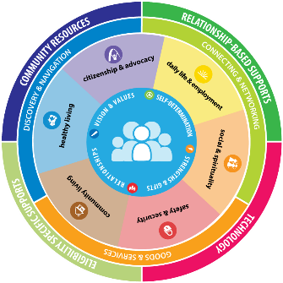
Vision for a Good Life
The future is not something we enter. The future is something that we create. And creating that future requires us to make choices and decisions that begin with a dream.
    -Leonard L. Sweet

Slide 32
What is YOUR Vision
for a Good LIFE?
Vision of What
I Want for a Quality of Life
Write down your responses on your worksheet & discuss

Slide 33
Thinking about People with Developmental Disability…
What would a life
they DON’T want look like?
Vision of What
I Don’t Want
Write down your responses on your worksheet & discuss

Slide 34

Three Types of Supports
Goods &
Services
(Day to Day, Medical, Financial Supports)
Discovery & Navigation
(Info, Training, Navigation, Planning)
Connecting & Networking
(Talking to Someone that has been there)

Slide 35
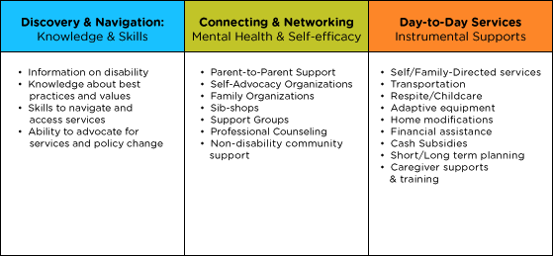
Types of Supports

Slide 36
Trajectory towards Good Life
Friends, family,
self-determination, community living, social capital and economic sufficiency
Trajectory towards Outcomes
Vision of What I Don’t Want
Trajectory towards things unwanted

Slide 37


a
Life
Medical spend down
Trajectory toward life
Adulthood
Guardianship
SSI
School
LABELED
WORLD
Poverty
Special programs
Depend upon public funding
Isolation – even segregation
Birth
Human Service Path
Disability path
Washington Community of Practice Adapted from National CoP Supports to Families, 2015

Slide 38
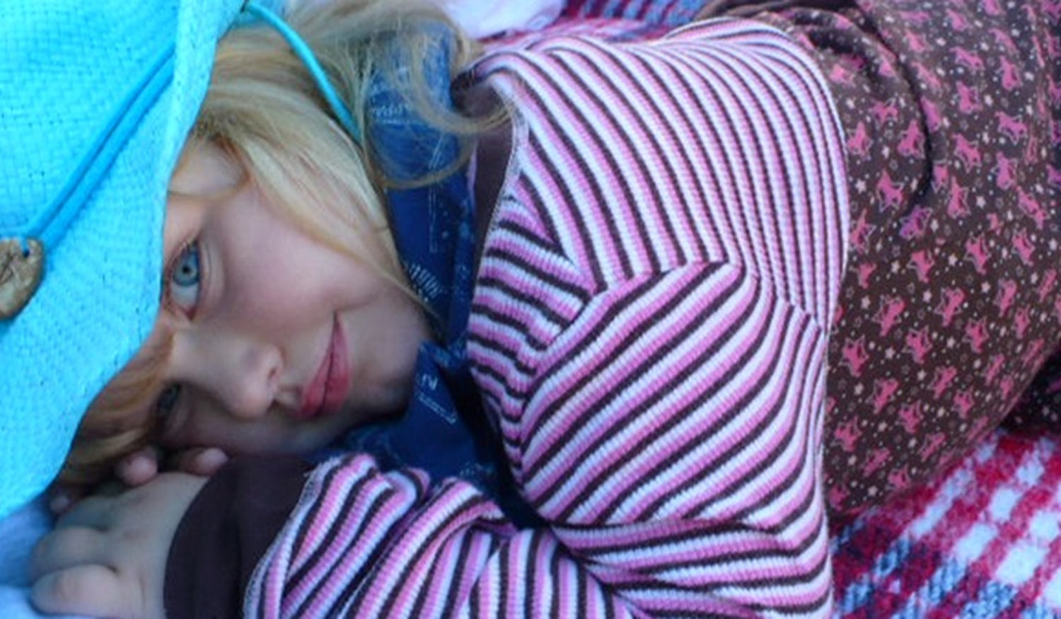

Impact of Info and Peer Support on
Elizabeth’s Life Trajectory
Self determination
Choice
Privacy
VISION for a GOOD LIFE
Uncharted trajectory self-cath
Peer Support/Research/Advocacy
Unnecessary medications
Unnecessary procedures
Limiting choices
Limiting self-determination
What I DON’T Want
Peer Support / Research /Advocacy
Charted trajectory ditropan
Charted trajectory stoma
5 Months…………….1 year…………………2 years

Slide 39






Focusing on Life Experiences
“Volunteering at church”
“Making mistakes”
Learning to say “no”
“Birthday parties with friends”
“Playing sports or an instrument”
“Chores and allowance”
Birth-----Early Child----School----Transition---Adulthood-------Aging
“Anticipatory Guidance for Life Experiences”

Slide 40
What were your “life experiences” that impacted your trajectory to employment?

Slide 41
Key Transition Points
My parents have passed away, what do I do?
I want to move out of my parents home?
How do I get around?
How do I get income to do what I want?
I want to have a girlfriend or boyfriend?
Parents Turn 65 y/o
Child Medicare & SSDI
Adulthood
Transition Plan with IDEA
Getting New Diagnosis
Should I get Social Security
Do I need a guardian?
Do I need to get on Medicaid?
Should I stay in school until 21 y/o?
Turning 18 y/o
Where will my child go during Summer?
What about before and after school care?
Leaving Early Childhood and entering school
Birth-----Early Child----School----Transition---Adulthood-------Aging

Slide 42






Thinking Across all Life Domains
Daily Life and Employment
(education/employment, life skills)
Healthy Living
(medical, behavioral and mental health, wellness, nutrition)
Community Living
(housing, transportation, community access)
Safety and Security
(emergencies, legal, well-being, guardianship and alternatives
Social and Spirituality
(friends, relationships and leisure activities)
Citizenship and Advocacy
(leadership, peer support, making choices, setting goals)

Slide 43
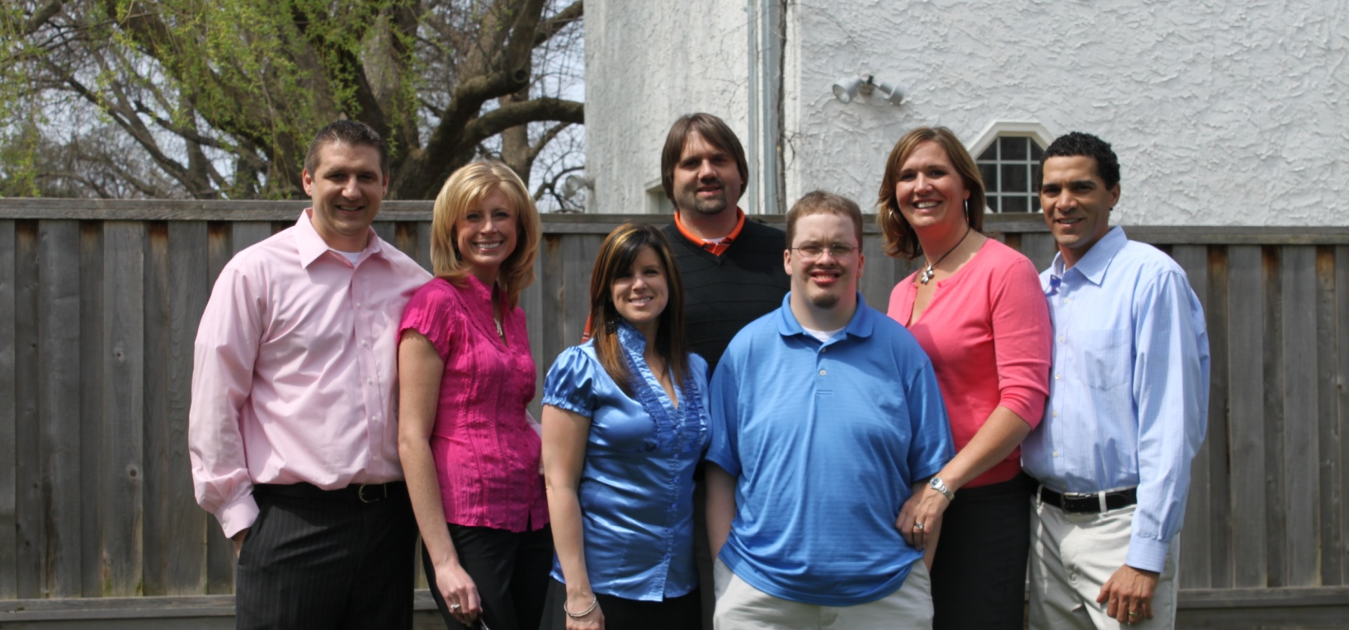
Understanding Life Possibilities and Systems that Support them

Slide 44

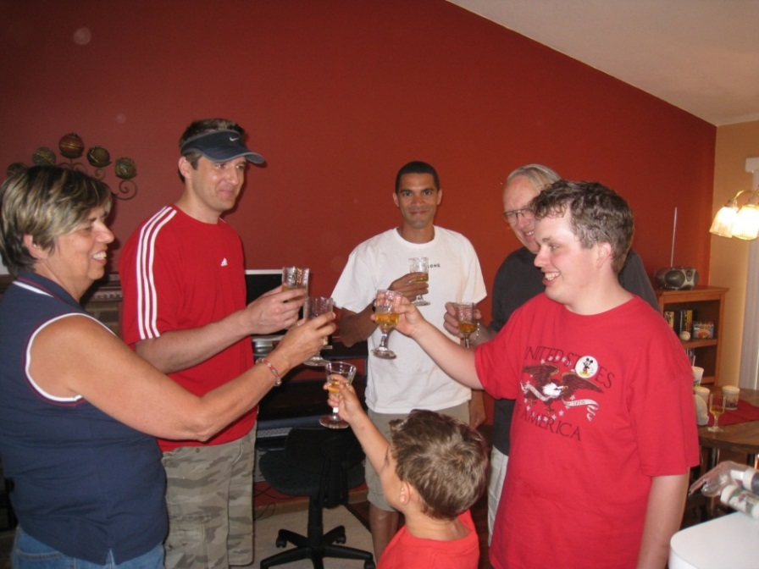
Community Living Possibilities
Vision for the Future
Innovative
Not Yet Discovered
Islands of Excellence
Own home Shared Living Space Co-op Environmental Adaptations Independent Supported Living
Traditional Options
Training Centers Intermediate Care Group Homes

Slide 45
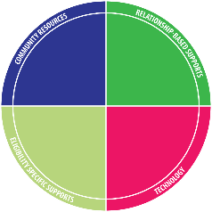
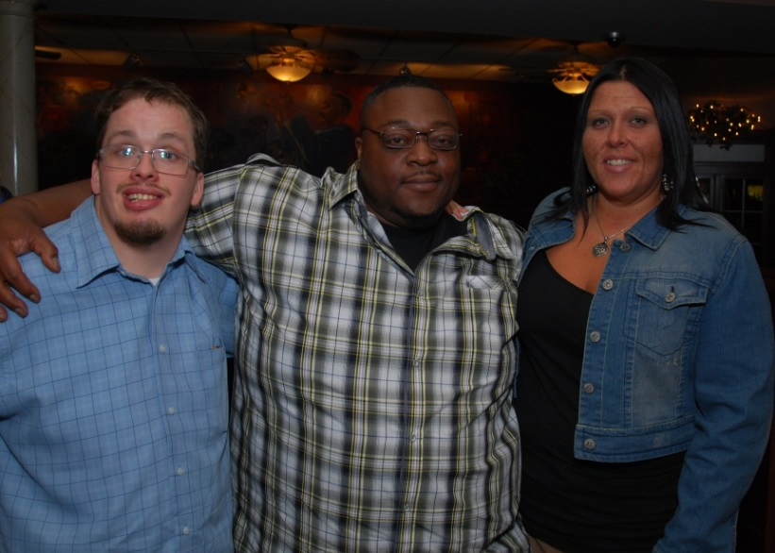
Service & Support Possibilities
Vision for the Future
Innovative
A new possibility
Islands of Excellence
Remote Monitoring Assistive Technology Time banks Human-service coops Self-directed Services Respite Micro-boards Companion Model
Traditional
Staff hired by Provider

Slide 46

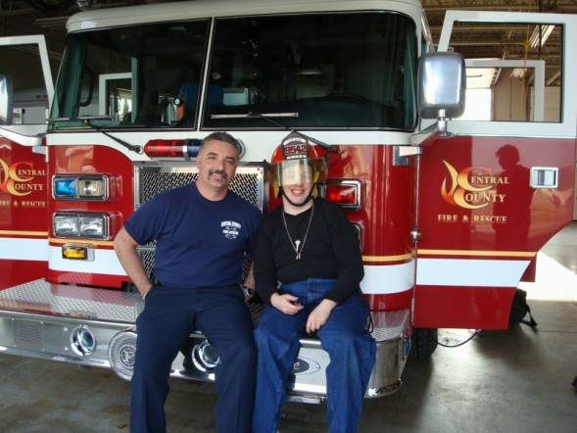
Daily Life/ Employment Possibilities
Vision for the Future
Innovative
New possibilities, needs discovery
Islands of Excellence
Micro-enterprise College/Tech Schools Career Military Supported Employment Volunteerism AmeriCorps/VISTA
Traditional
Sheltered Workshops Day Habilitation

Slide 47
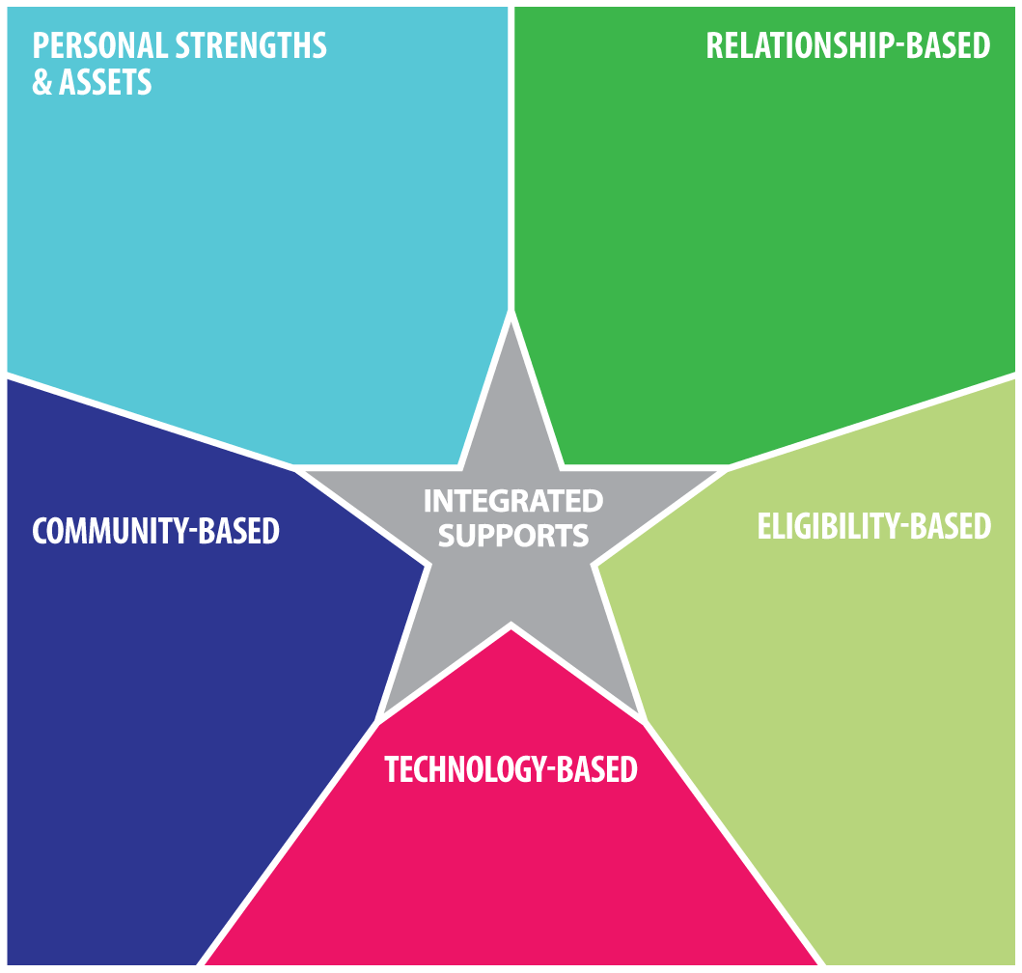
Need Assistance in Developing and Integrating Supports and Services
Person or family resources, abilities, strengths, characteristics
Family, friends, neighbors, co-workers, community members, church members
Disability Services,
Special Education
Medicaid,
Housing,
Food Stamps, Vocational rehab (VR)
School, businesses,
Church/faith based,
public transportation,
Parks and recreation
i-pad/smart phone apps,
remote monitoring,
cognitive accessibility,
adaptive equipment

Slide 48
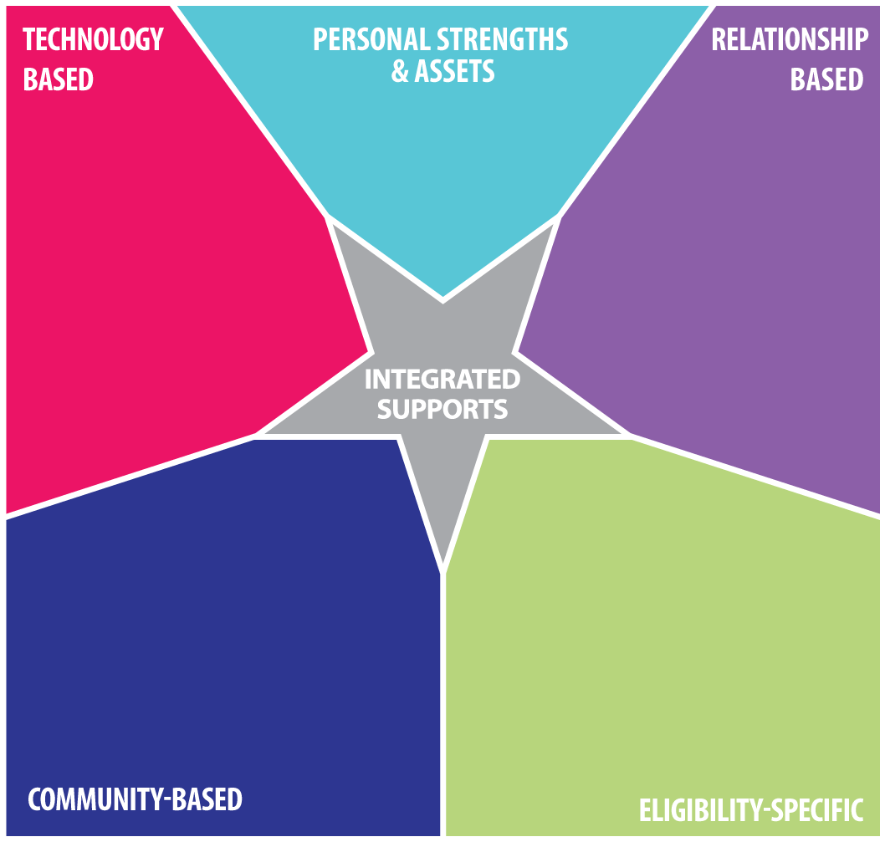
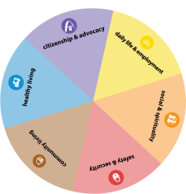
Adapting, Accommodating and Integrating Supports:
Specific Life Domain
Life Domains

Slide 49

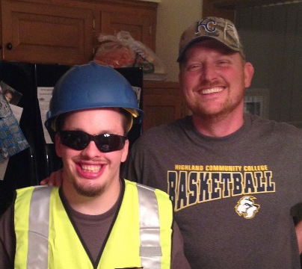
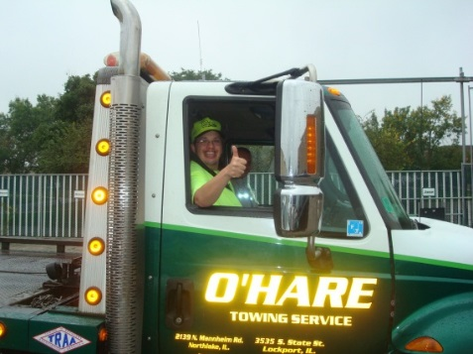

Eric’s Focus on Social and Spiritual
Happy, Funny and loving
Likes to help people
Likes to try new things
Police cars, tow trucks, fire engines and racecars
Golf Cart
See his girlfriend more
Connect with his family
Spend more time with friends
Scouts
Red Robin
Race Tracks
Companion Supports
day-to-day
I-pad
Smart Phone

Slide 50
No Wrong Door SYSTEM
Additional Sources
of Referral
State DD Agencies
Vocational Rehabilitation
Medical Homes or Health Homes, including Pediatric Offices
Early Childhood Programs
Schools and Colleges
Family and Self-Advocacy Networks
Individuals with DD and their Families may have
LIFE LONG Long Term Service Needs…

Slide 51

Partnering with Person with Disability and their Families so they can
Engage, Lead, and Drive
Their Own Lives and
Policy and Systems Change

Slide 52
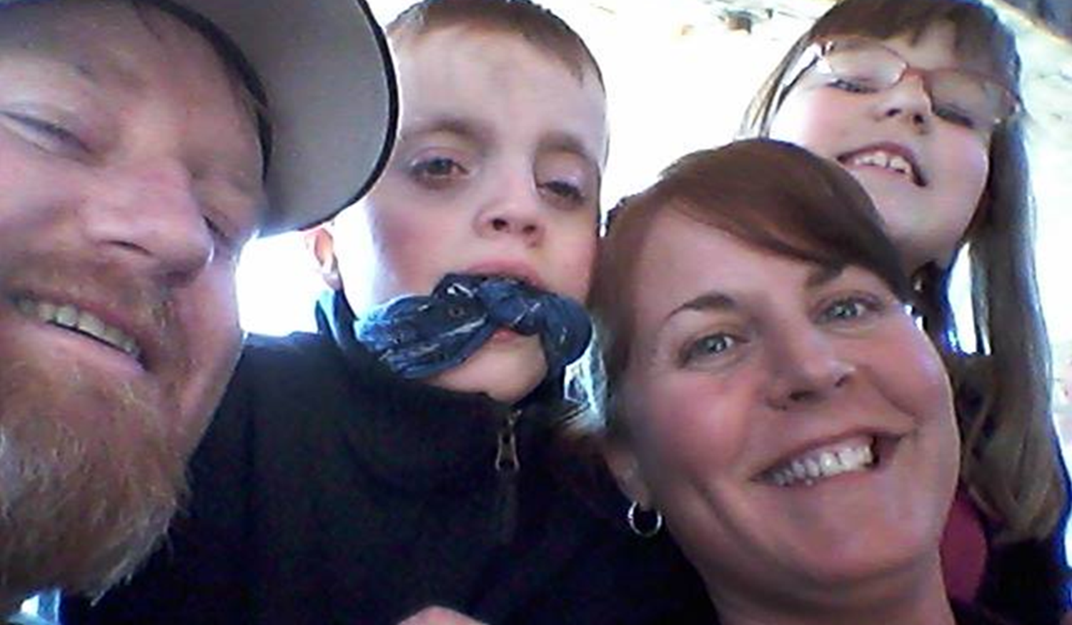
Examples of the LIfeCourse
Framework in Action

Slide 53
Where do individuals and families “plan”?
Schools
Doctors
Vocational Rehabilitation
Lawyers
Support Coordinators for Medicaid LTSS/Division of DD
Family Members

Slide 54
Peyton’s Integrated School
Story
How the Story Began: Peyton
  Family wants Peyton to attend the neighborhood school with his brother and his school age peers
  School believes that Peyton will be best supported in a next year in a segregated setting, in a different building which does not have students his age
  During the IEP meeting, the school and parent became grid-locked on a what more inclusive day could look like for Peyton (he was not included in homeroom, lunch, specials or other general education class)
  Two weeks later, Mom brought Peyton’s trajectory, integrated star and weekly schedule to the follow-up IEP. The school better understood what she wanted and have made more concrete strides at meeting his inclusion needs.
Individualized Education Plan

Slide 55
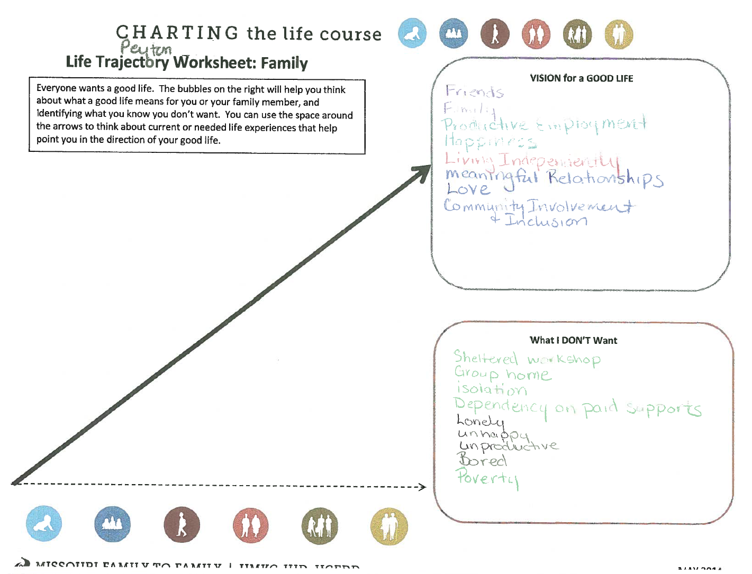
Peyton’s Good “School” Life

Slide 56
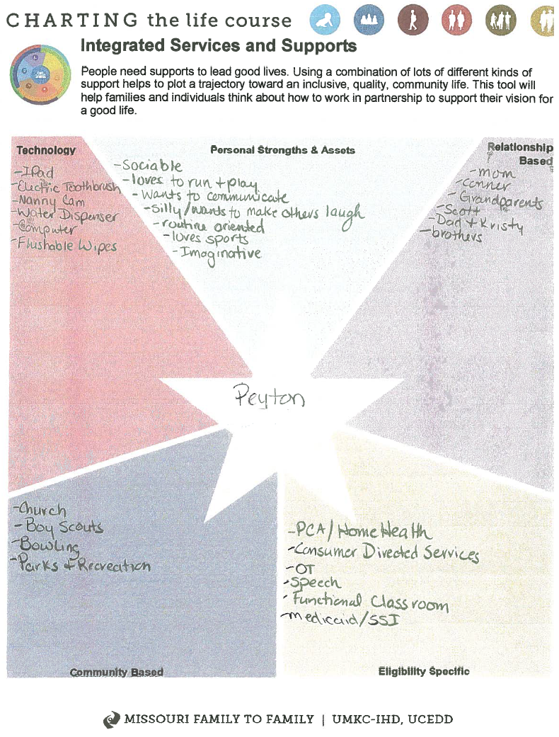
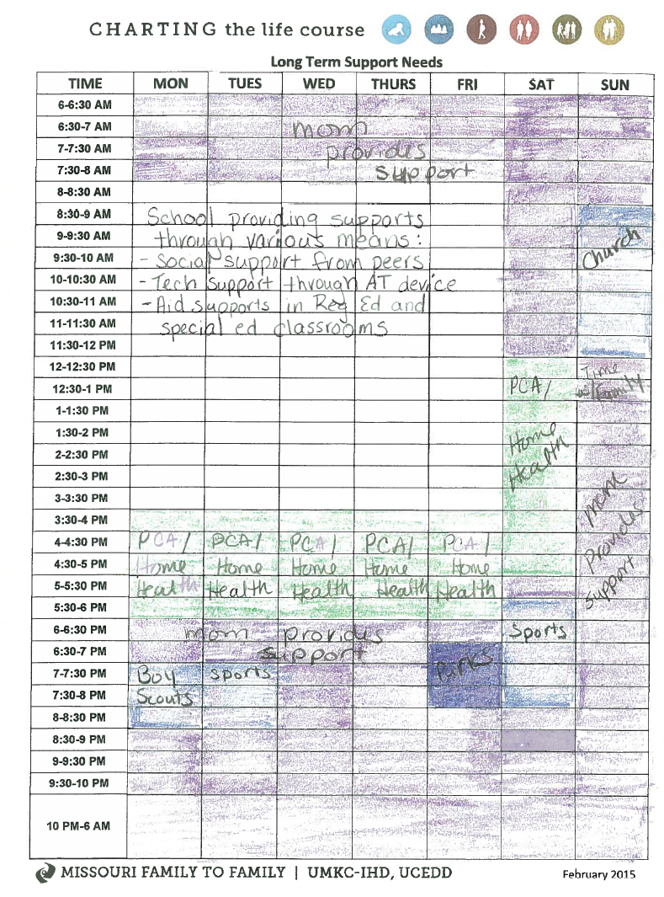
Peyton’s Integrated Good Life

Slide 57
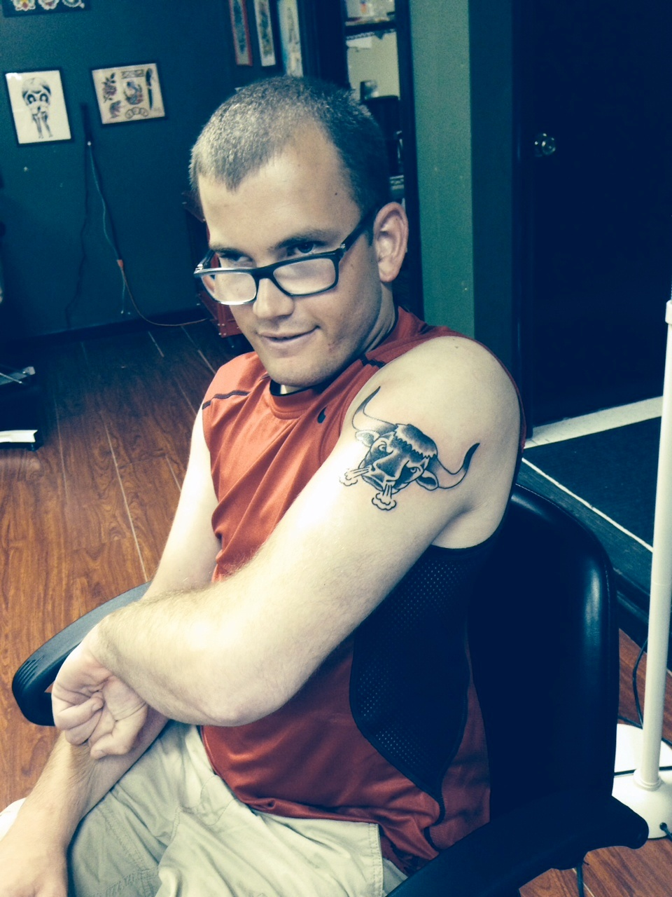
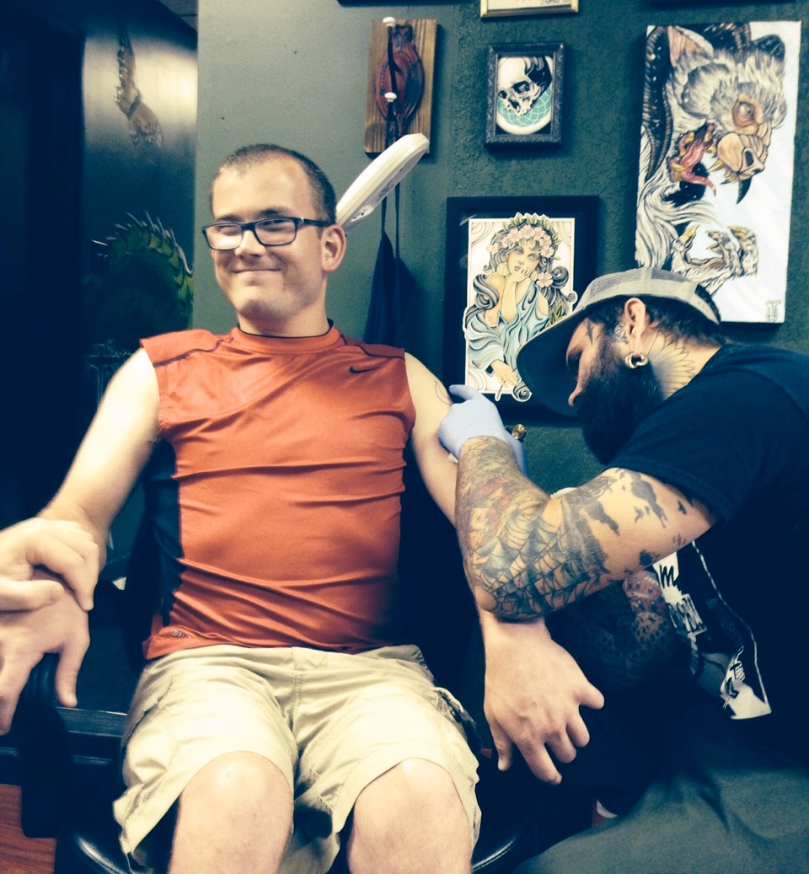
Ben’s GOOD LIFE as Told by Mom

Slide 58
Tools Used for Planning and Day-to-Day Supports for
DMH Division of DD
(Ben’s One Page Profile)

Slide 59
Ben’s Life Trajectory

Slide 60
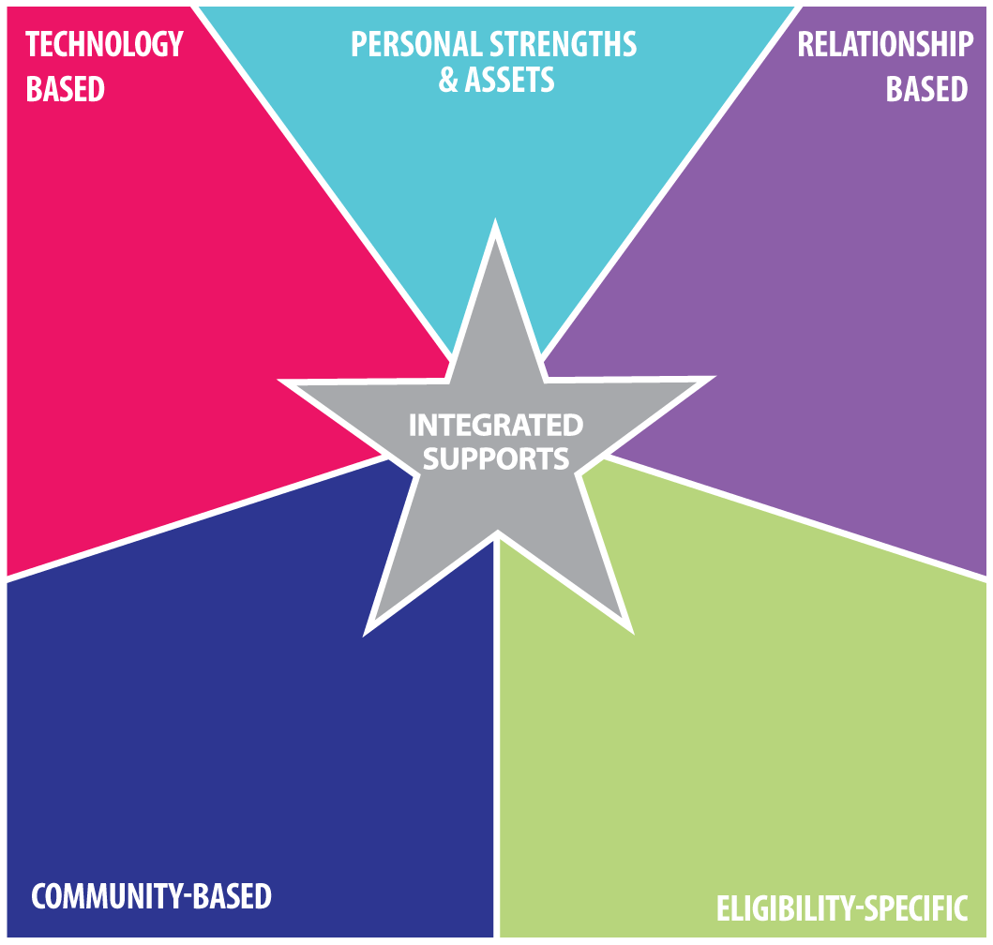
Ben’s Integrated Services and Supports Star
Outgoing personality, friendly, Eagle Scout,
can ride city bus
Dad, Mom, Matt, Zac, Ali, Chad, Ericka, Sheli,
Firemen friends,
Ange, Pam, Wally, Josh B., Matt S.,
Mike, Nick,
Scouting friends
I-pad, apps, Facebook,
Facetime,
Digital watch,
Vibrating toothbrush,
Glasses
Ben’s
Omni bus, Walmart,
24 Hour Fitness,
library, Price Chopper, Dr. T.,
St. Ann’s church, ES Fire Dept,
joint bank account, direct deposit, Power of attorney
PCA –DDD, self-
directed supports
Social Security,
Medicaid, Special
Needs Trust

Slide 61
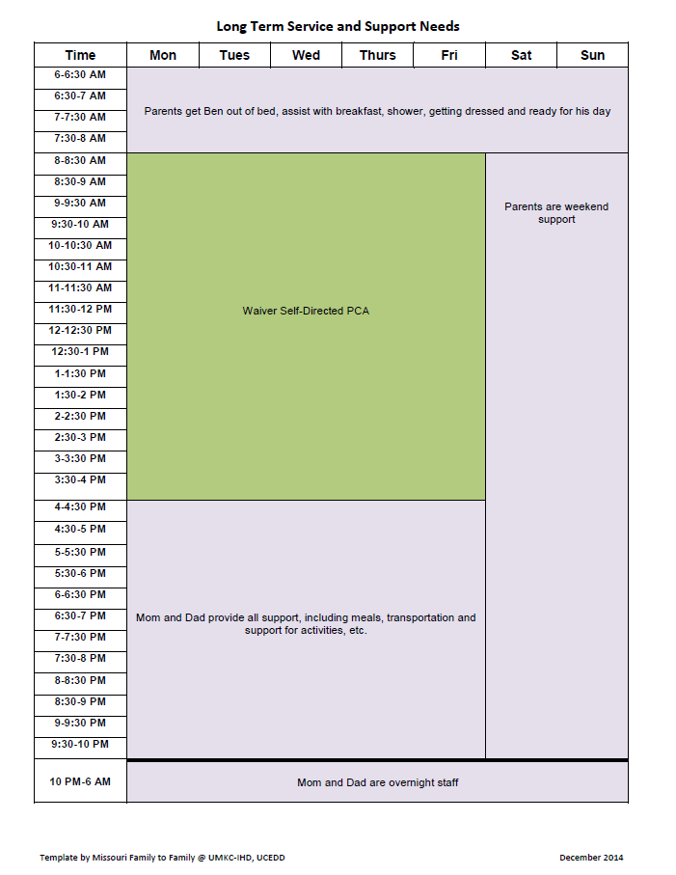
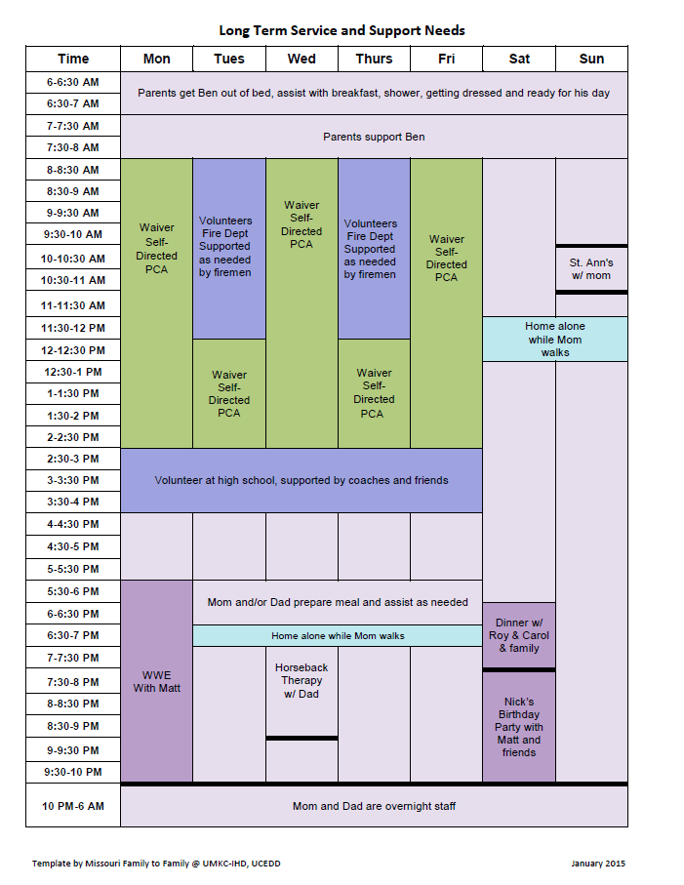
Integrating Supports into Real Life

Slide 62
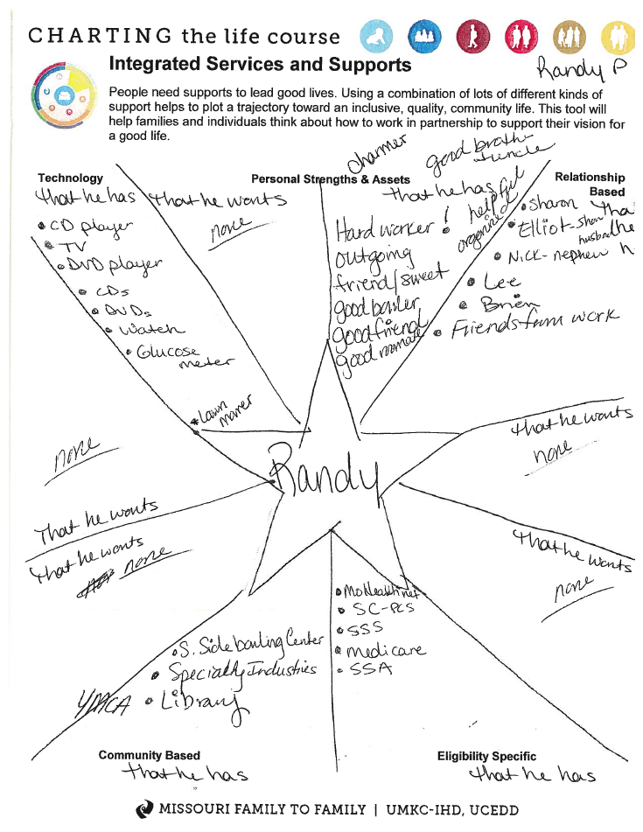
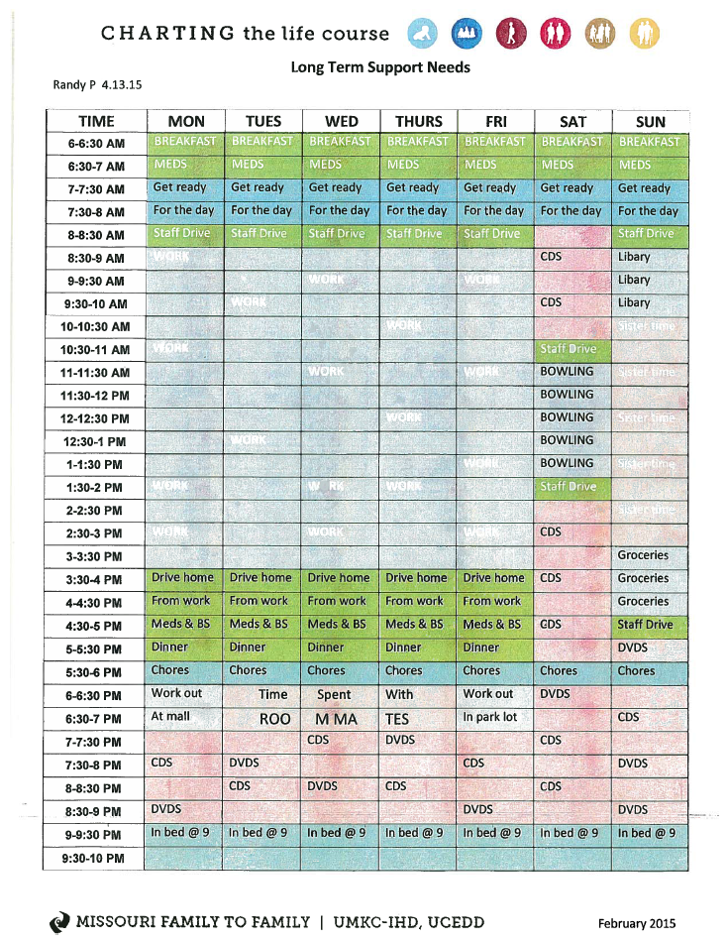
Randy’s Good Life
Notes:
The star is split into what he has now, and what he wants to work on getting.

Slide 63
No Wrong Door SYSTEM
LifeCourse Tools focusing on Adapting, Accommodating and
Integrating Supports:
Own Strengths, Assets and Resources
Technology
Relationships
Community Resources
Eligibility Specific Services and Supports
Planning may require identifying, developing and adapting supports beyond private and public supports

Slide 64
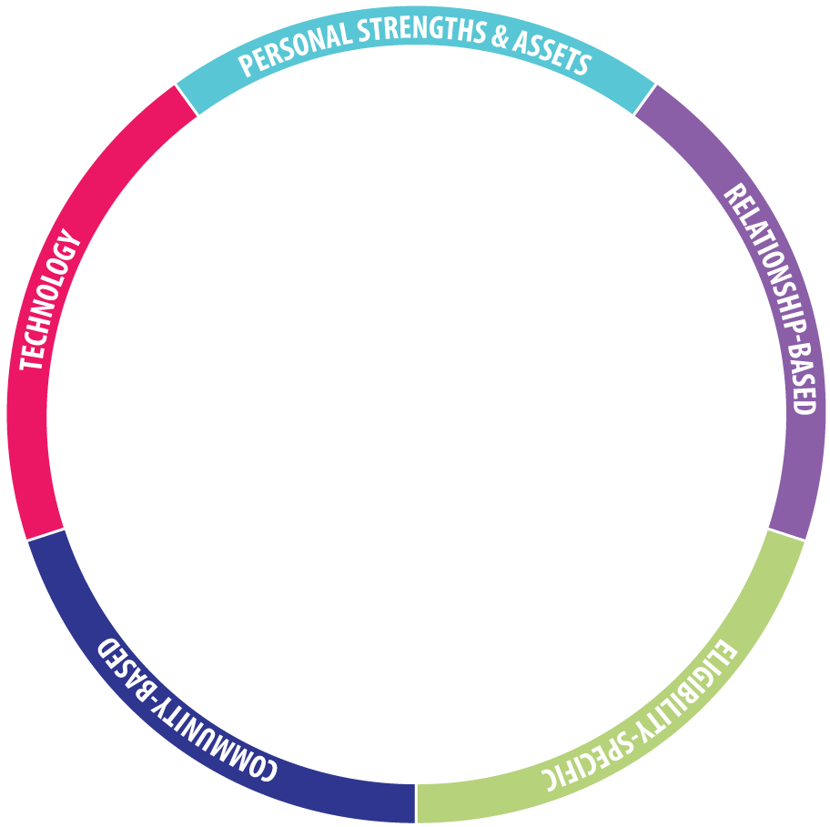
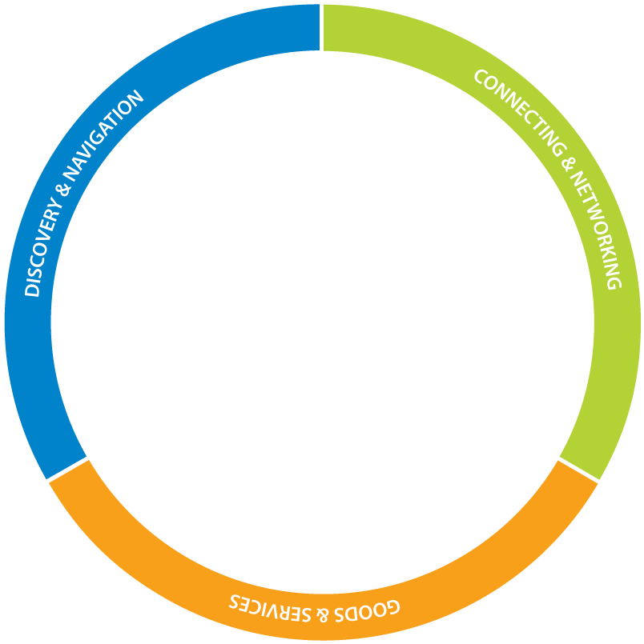
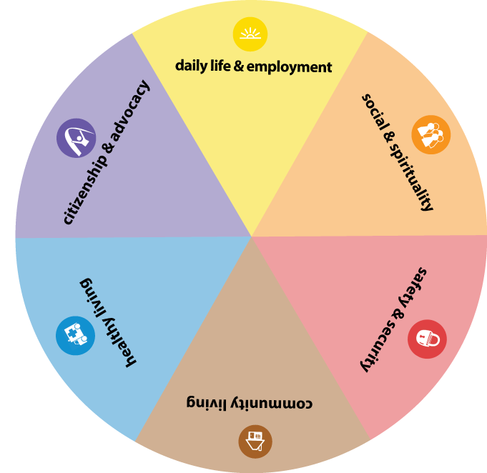


Supporting Good Lives!
Notes:
First show the person,
Then show the family,
then bring up the domains
And then the buckets
And then the outer layers
All these things work together to make a good life.

Slide 65
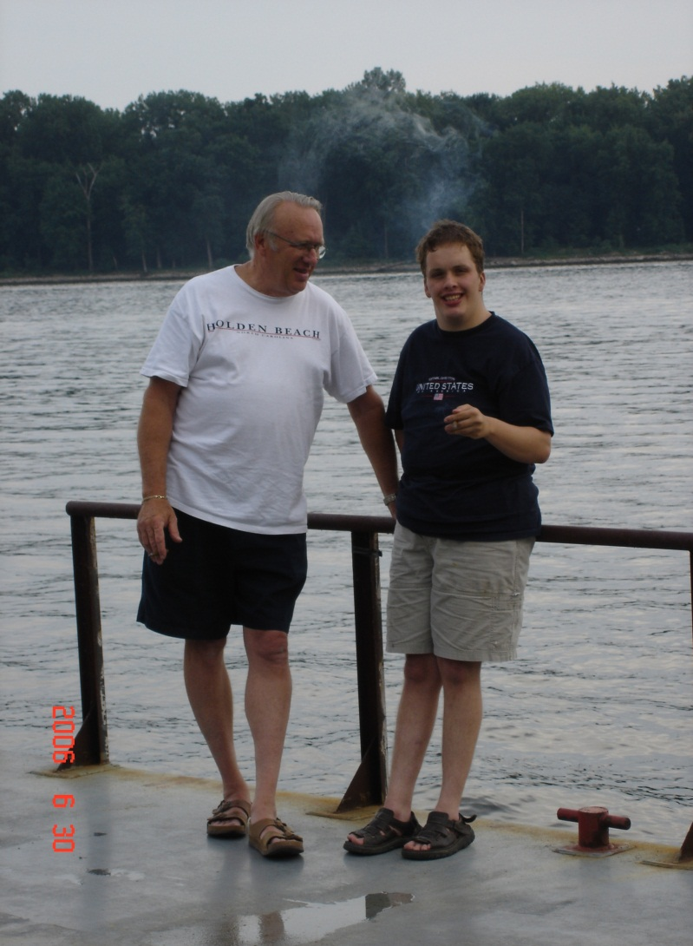
Life isn’t about how to survive the storm, but how to dance in the rain.
-unknown

Slide 66
Questions, Reflections and Discussion

Slide 67
Contact Information
Sheli Reynolds reynoldsmc@umkc.edu
Mary Lee Fay mlfay@nasddds.org

